Slide 1
MGS 723: Geodynamics
Classes 27 & 28: The Finite Element Method
Main references for today: Becker and Kaus, Numerical Geodynamics
Hughes, 2000, The Finite Element Method

Slide 2
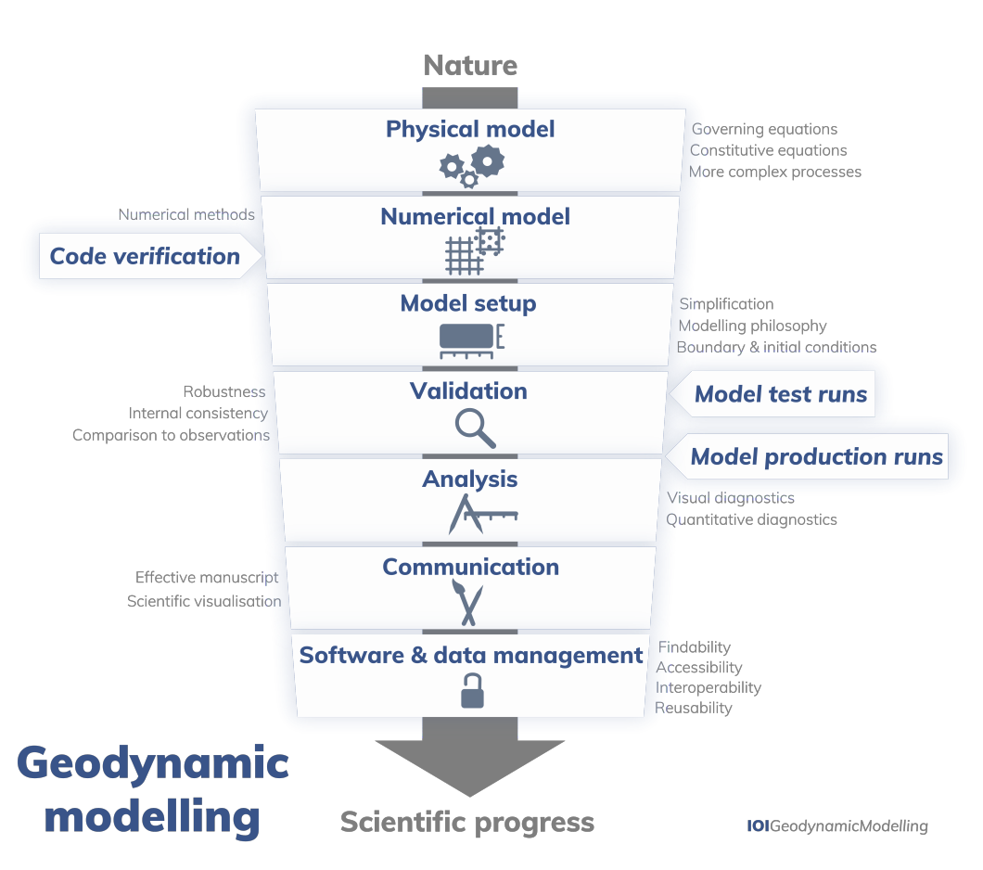
Geodynamic Modeling
The procedure:
Today:
Physical model
Numerical model
Model setup
van Zelst et al., 2021

Slide 3
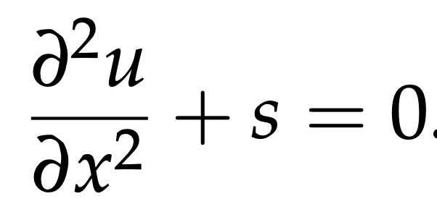
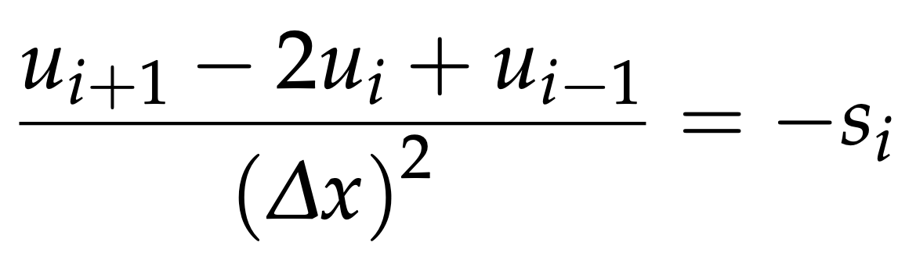
Two main numerical solution methods
Finite differences
Approximates derivatives by Taylor series. Combine approximated derivatives to solve full equation on a grid, e.g.:
Pros: conceptually simple, approximates the PDE
Cons: bad for sharp contrasts in properties, bad for complex model geometries.

Slide 4
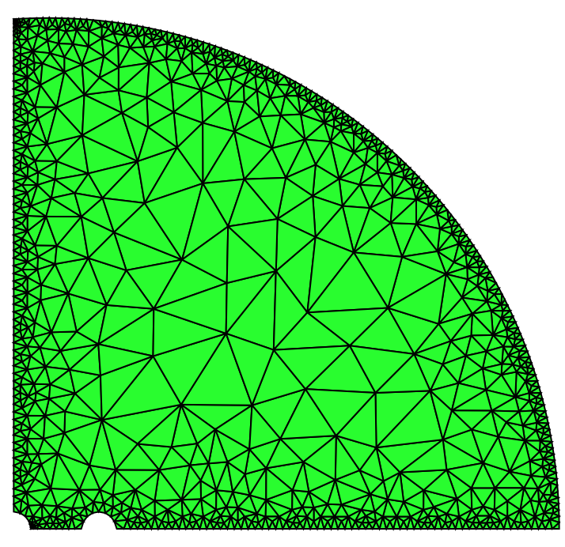
Two main numerical solution methods
Finite differences
Finite elements
Approximates derivatives by Taylor series. Combine approximated derivatives to solve full equation on a grid, e.g.:
Pros: conceptually simple, approximates the PDE
Cons: bad for sharp contrasts in properties, bad for complex model geometries.
Approximates the PDE solution (instead of the PDE) using integrals.
Pros: good for sharp contrasts in properties and complex model geometries, allow mesh refinement
Cons: conceptually trickier, need to carefully choose type of elements, integration methods, etc. etc.

Slide 5
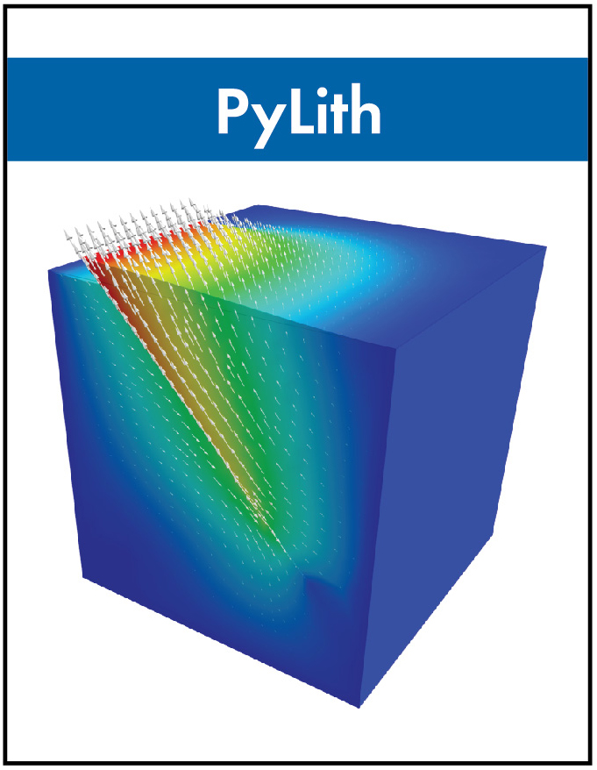

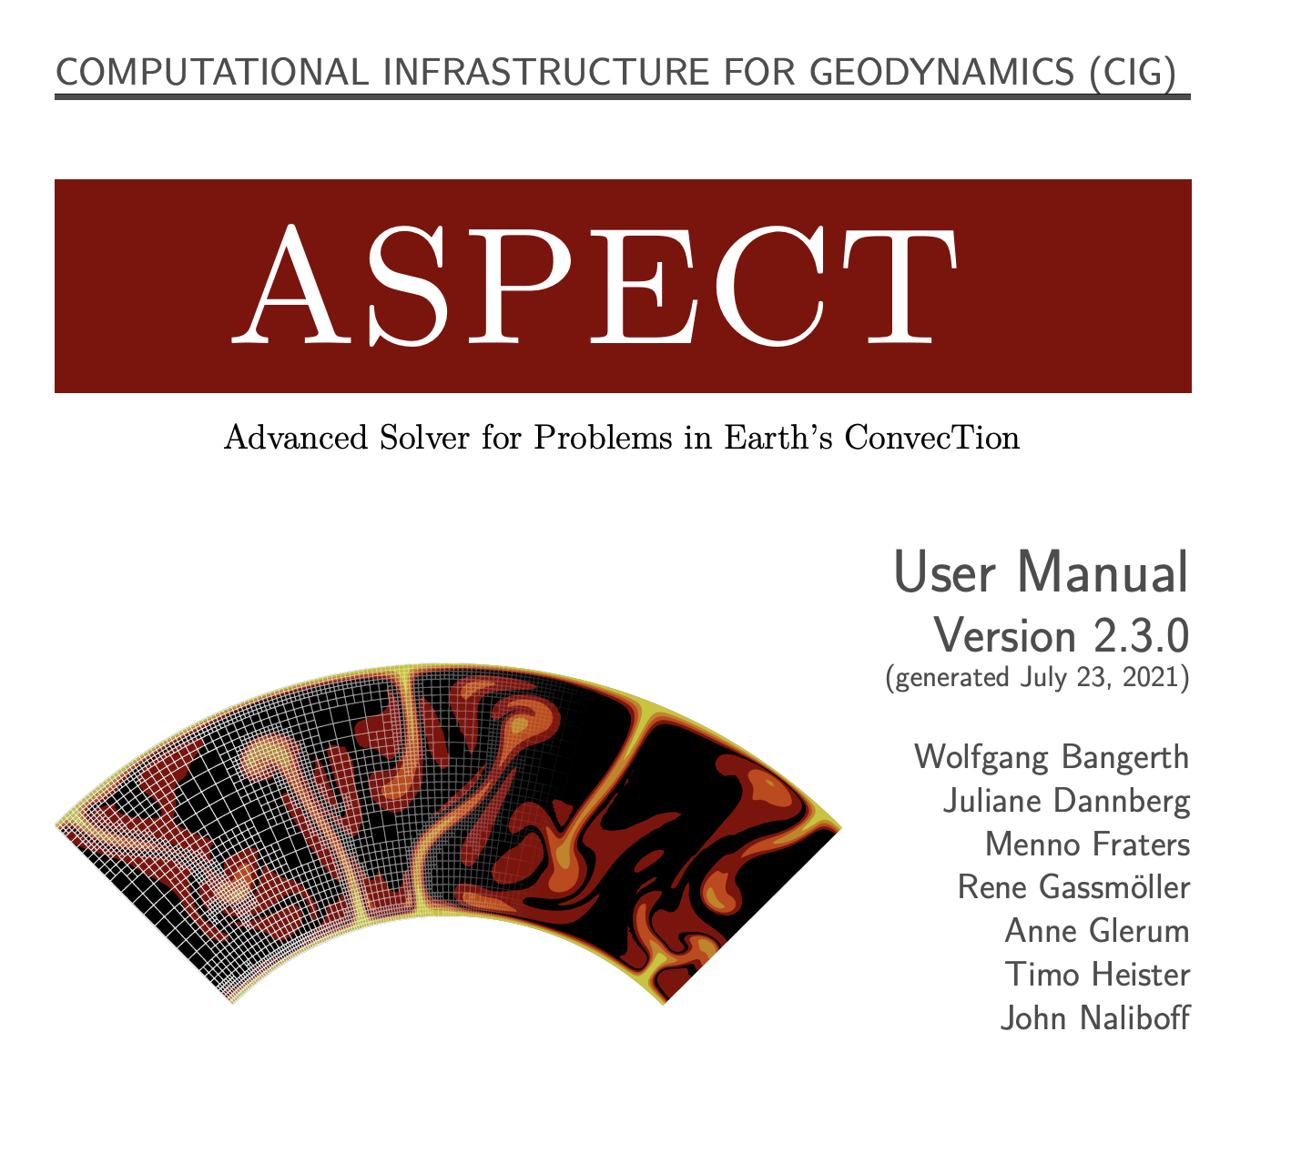
Some finite element codes

Slide 6
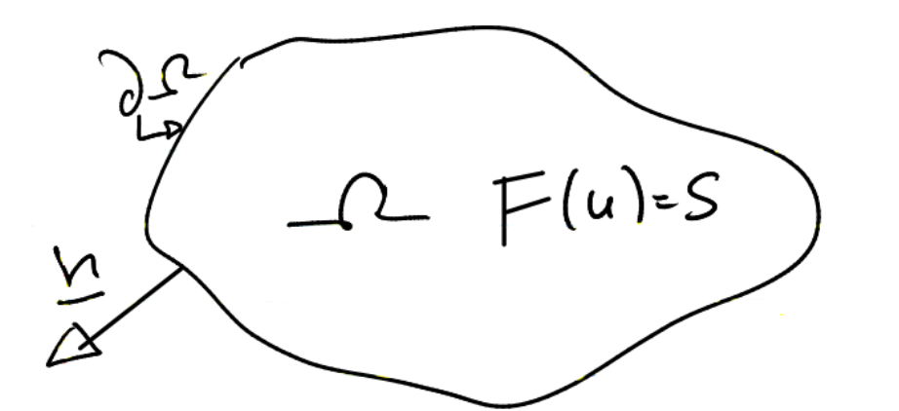
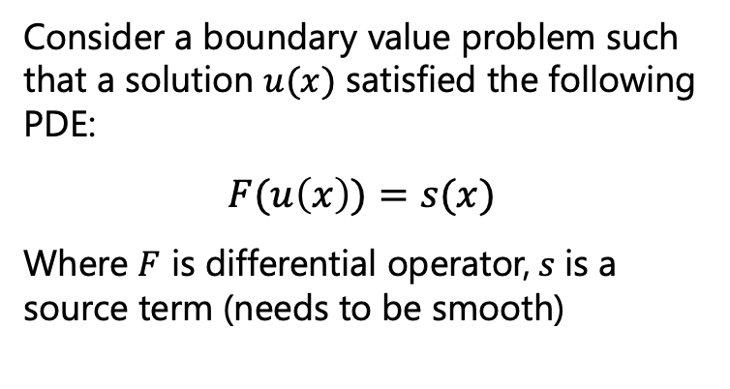
Finite element philosophy
Consider a boundary value problem such that a solution $u(x)$ satisfied the following PDE:
$$F(u\left(x\right))=s(x)$$
Where $F$ is differential operator, $s$is a source term (needs to be smooth)
Becker and Kaus, Numerical Geodynamics

Slide 7
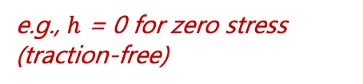
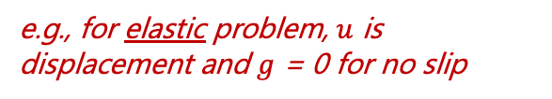
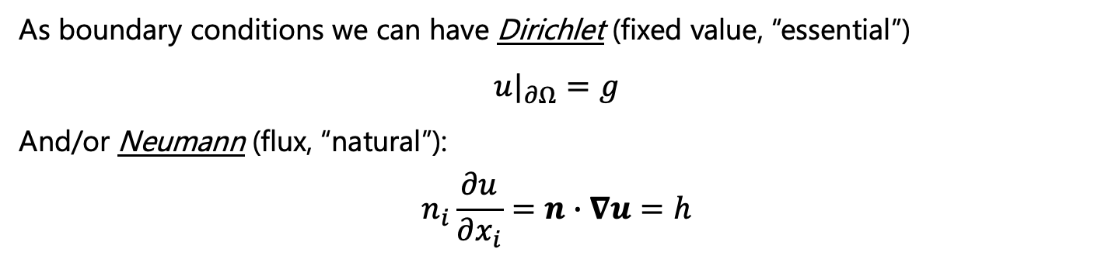
Finite element philosophy
Consider a boundary value problem such that a solution $u(x)$ satisfied the following PDE:
$$F(u\left(x\right))=s(x)$$
Where $F$ is differential operator, $s$is a source term (needs to be smooth)
As boundary conditions we can have Dirichlet (fixed value, “essential”)
$$u|_{∂Ω}=g$$
And/or Neumann (flux, “natural”):
$$n_{i}\frac{∂u}{∂x_{i}}=n∙∇u=h$$
e.g., for elastic problem, $u$ is displacement and $g$ = 0 for no slip
e.g., $h$ = 0 for zero stress (traction-free)
Becker and Kaus, Numerical Geodynamics

Slide 8
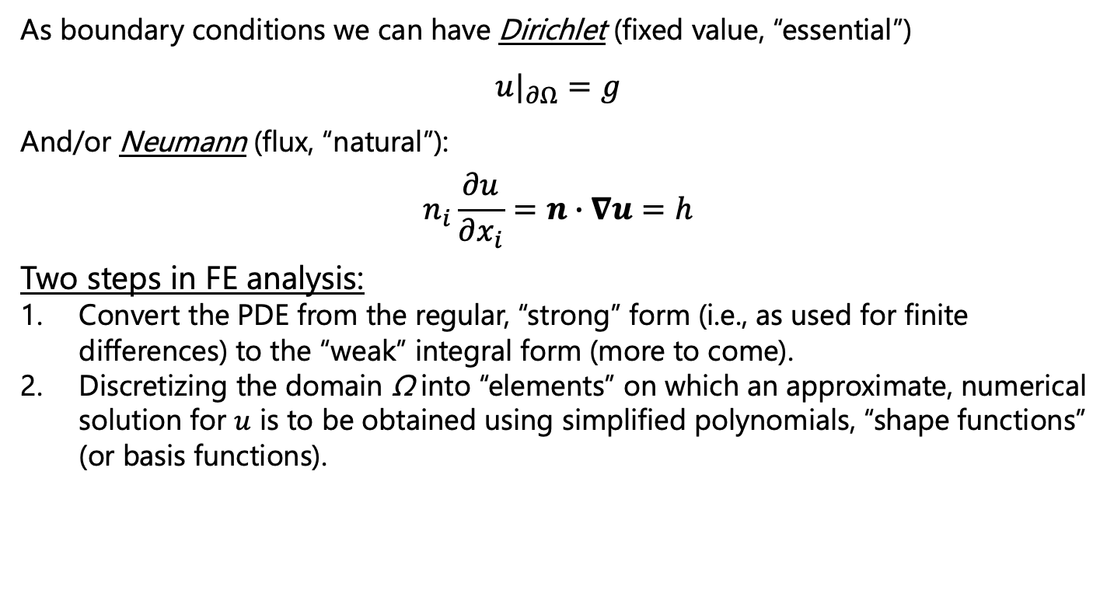
Finite element philosophy
Consider a boundary value problem such that a solution $u(x)$ satisfied the following PDE:
$$F(u\left(x\right))=s(x)$$
Where $F$ is differential operator, $s$is a source term (needs to be smooth)
As boundary conditions we can have Dirichlet (fixed value, “essential”)
$$u|_{∂Ω}=g$$
And/or Neumann (flux, “natural”):
$$n_{i}\frac{∂u}{∂x_{i}}=n∙∇u=h$$
Two steps in FE analysis:
Convert the PDE from the regular, “strong” form (i.e., as used for finite differences) to the “weak” integral form (more to come).
Discretizing the domain Ω into “elements” on which an approximate, numerical solution for $u$ is to be obtained using simplified polynomials, “shape functions” (or basis functions).
Becker and Kaus, Numerical Geodynamics

Slide 9
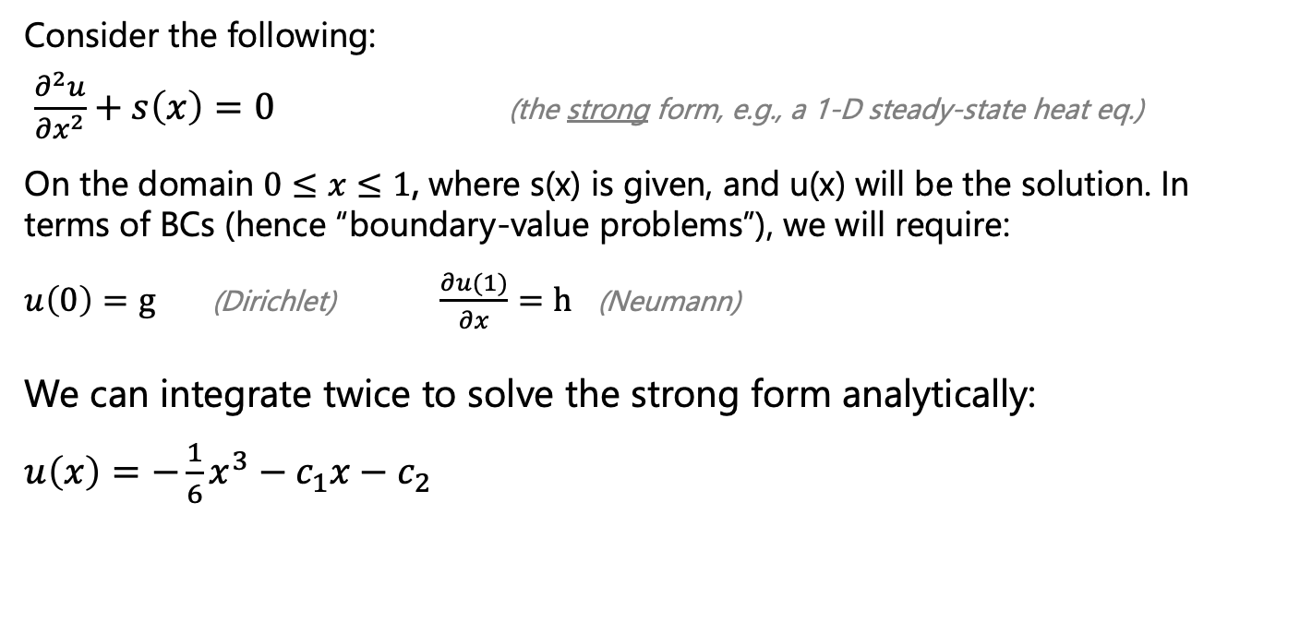
A simple, 1-D example
Consider the following:
$\frac{∂^{2}u}{∂x^{2}}+s\left(x\right)=0$ (the strong form, e.g., a 1-D steady-state heat eq.)
On the domain $0≤x≤1$, where s(x) is given, and u(x) will be the solution. In terms of BCs (hence “boundary-value problems”), we will require:
$u\left(0\right)=g$ (Dirichlet) $\frac{∂u(1)}{∂x}=h$ (Neumann)
We can integrate twice to solve the strong form analytically:
$u\left(x\right)=−\frac{1}{6}x^{3}−c_{1}x−$ $c_{2}$
Becker and Kaus, Numerical Geodynamics

Slide 10
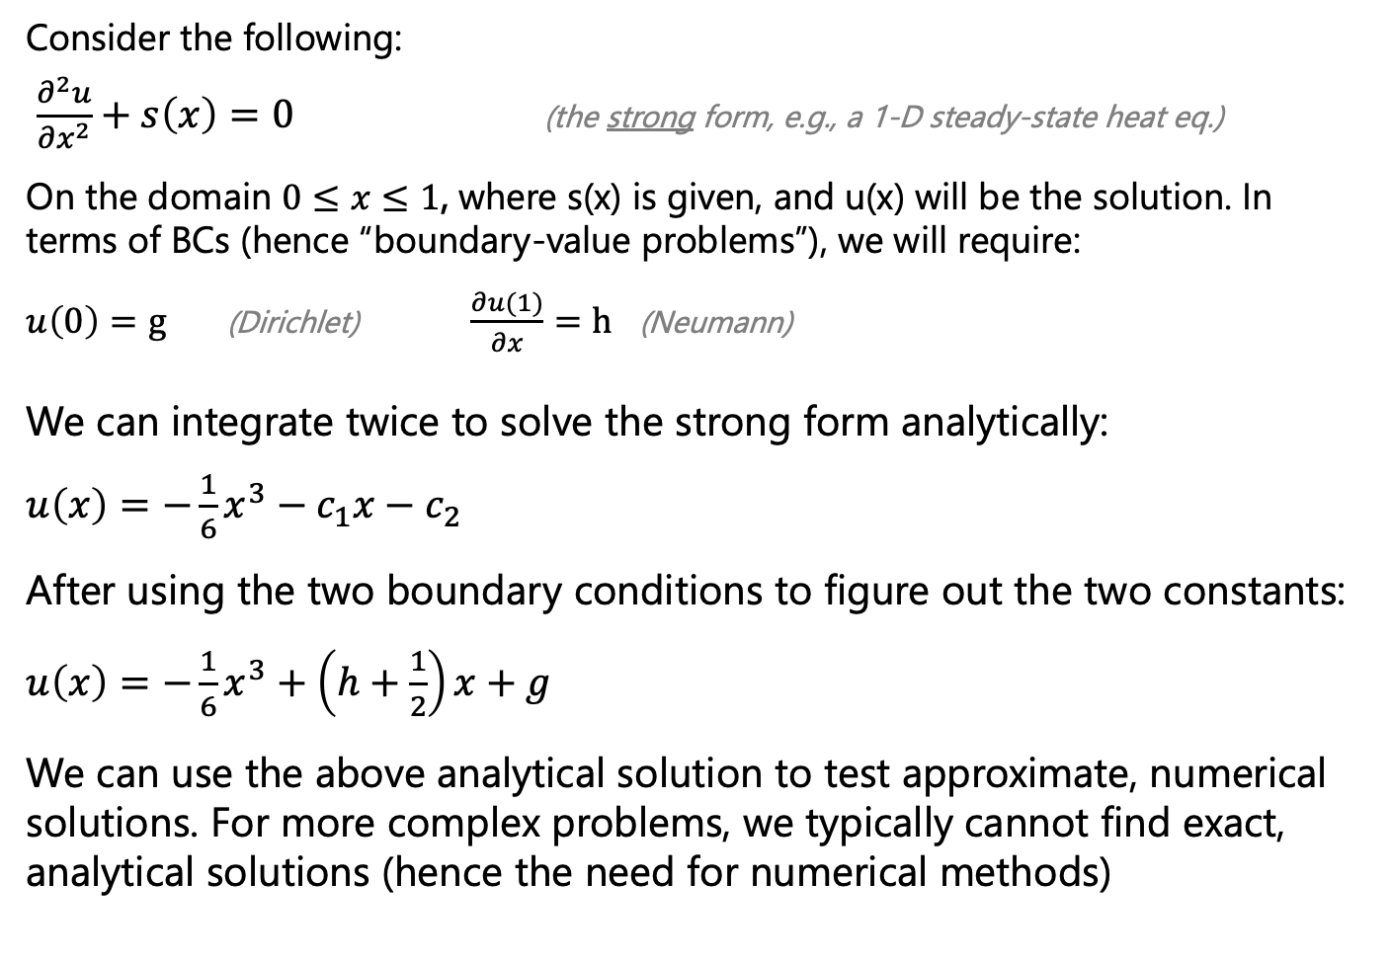
A simple, 1-D example
Consider the following:
$\frac{∂^{2}u}{∂x^{2}}+s\left(x\right)=0$ (the strong form, e.g., a 1-D steady-state heat eq.)
On the domain $0≤x≤1$, where s(x) is given, and u(x) will be the solution. In terms of BCs (hence “boundary-value problems”), we will require:
$u\left(0\right)=g$ (Dirichlet) $\frac{∂u(1)}{∂x}=h$ (Neumann)
We can integrate twice to solve the strong form analytically:
$u\left(x\right)=−\frac{1}{6}x^{3}−c_{1}x−$ $c_{2}$
After using the two boundary conditions to figure out the two constants:
$u\left(x\right)=−\frac{1}{6}x^{3}+\left(h+\frac{1}{2}\right)x+g$
We can use the above analytical solution to test approximate, numerical solutions. For more complex problems, we typically cannot find exact, analytical solutions (hence the need for numerical methods)
Becker and Kaus, Numerical Geodynamics

Slide 11
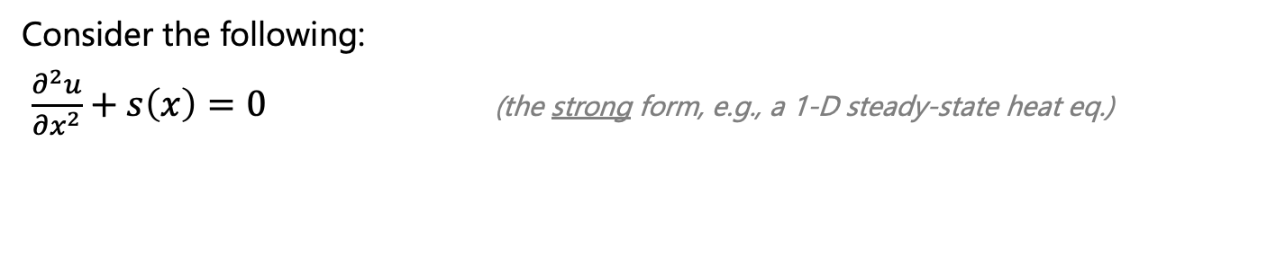
A simple, 1-D example
Consider the following:
$\frac{∂^{2}u}{∂x^{2}}+s\left(x\right)=0$ (the strong form, e.g., a 1-D steady-state heat eq.)
Becker and Kaus, Numerical Geodynamics

Slide 12
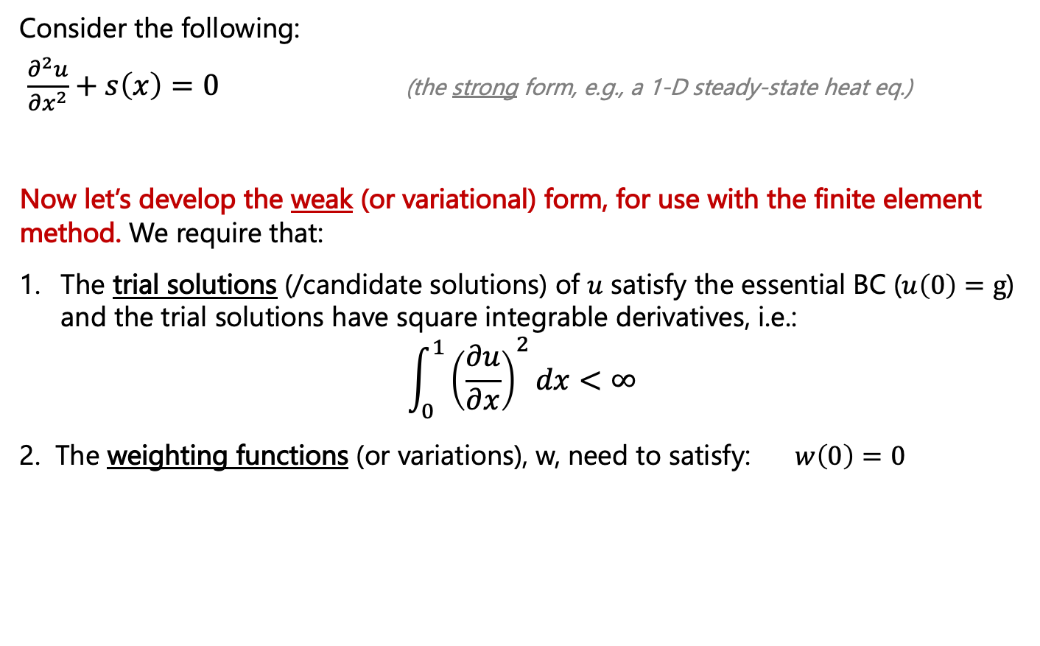
A simple, 1-D example
Consider the following:
$\frac{∂^{2}u}{∂x^{2}}+s\left(x\right)=0$ (the strong form, e.g., a 1-D steady-state heat eq.)
Now let’s develop the weak (or variational) form, for use with the finite element method. We require that:
The trial solutions (/candidate solutions) of $u$ satisfy the essential BC ($u\left(0\right)=g$) and the trial solutions have square integrable derivatives, i.e.:
$$\int_{0}^{1}{{\left(\frac{∂u}{∂x}\right)}^{2}dx<∞}$$
2. The weighting functions (or variations), w, need to satisfy: $w\left(0\right)=0$
Becker and Kaus, Numerical Geodynamics

Slide 13
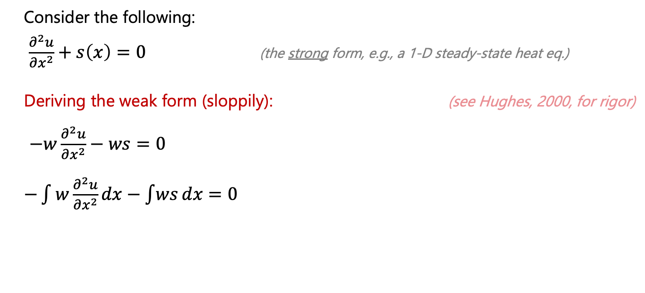
A simple, 1-D example
Consider the following:
$\frac{∂^{2}u}{∂x^{2}}+s\left(x\right)=0$ (the strong form, e.g., a 1-D steady-state heat eq.)
Deriving the weak form (sloppily): (see Hughes, 2000, for rigor)
$−w\frac{∂^{2}u}{∂x^{2}}−ws=0$
$−\int{w\frac{∂^{2}u}{∂x^{2}}}dx−\int{ws}dx=0$
Becker and Kaus, Numerical Geodynamics

Slide 14
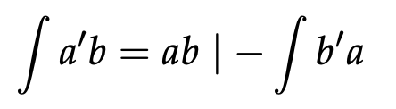
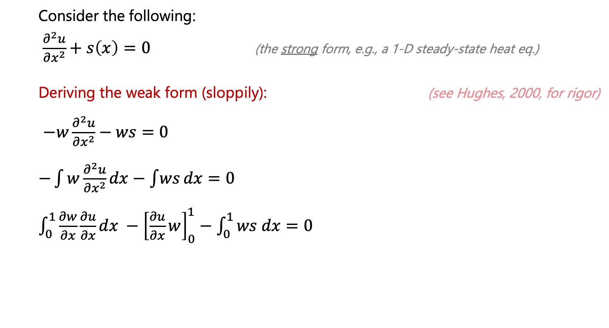
A simple, 1-D example
Consider the following:
$\frac{∂^{2}u}{∂x^{2}}+s\left(x\right)=0$ (the strong form, e.g., a 1-D steady-state heat eq.)
Deriving the weak form (sloppily): (see Hughes, 2000, for rigor)
$−w\frac{∂^{2}u}{∂x^{2}}−ws=0$
$−\int{w\frac{∂^{2}u}{∂x^{2}}}dx−\int{ws}dx=0$
$\int_{0}^{1}{\frac{∂w}{∂x}\frac{∂u}{∂x}dx} −{\left[\frac{∂u}{∂x}w\right]}_{0}^{1}−\int_{0}^{1}{ws dx}=0$
Integration by parts rule:
Becker and Kaus, Numerical Geodynamics

Slide 15
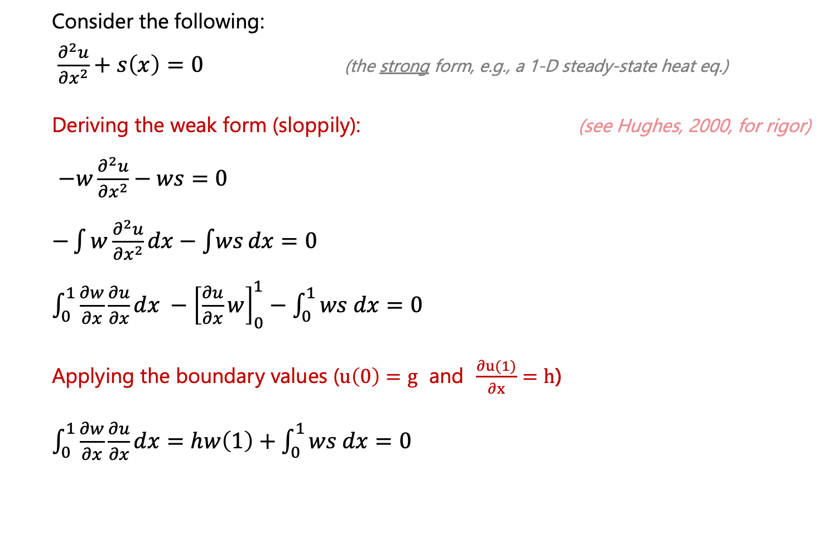
A simple, 1-D example
Consider the following:
$\frac{∂^{2}u}{∂x^{2}}+s\left(x\right)=0$ (the strong form, e.g., a 1-D steady-state heat eq.)
Deriving the weak form (sloppily): (see Hughes, 2000, for rigor)
$−w\frac{∂^{2}u}{∂x^{2}}−ws=0$
$−\int{w\frac{∂^{2}u}{∂x^{2}}}dx−\int{ws}dx=0$
$\int_{0}^{1}{\frac{∂w}{∂x}\frac{∂u}{∂x}dx} −{\left[\frac{∂u}{∂x}w\right]}_{0}^{1}−\int_{0}^{1}{ws dx}=0$
Applying the boundary values ($u\left(0\right)=g$ and $\frac{∂u(1)}{∂x}=h$)
$\int_{0}^{1}{\frac{∂w}{∂x}\frac{∂u}{∂x}dx}=hw\left(1\right)+\int_{0}^{1}{ws dx}=0$
Integration by parts rule:
Becker and Kaus, Numerical Geodynamics

Slide 16
A simple, 1-D example
Consider the following:
$\frac{∂^{2}u}{∂x^{2}}+s\left(x\right)=0$ (the strong form, e.g., a 1-D steady-state heat eq.)
Deriving the weak form (sloppily): (see Hughes, 2000, for rigor)
$−w\frac{∂^{2}u}{∂x^{2}}−ws=0$
$−\int{w\frac{∂^{2}u}{∂x^{2}}}dx−\int{ws}dx=0$
$\int_{0}^{1}{\frac{∂w}{∂x}\frac{∂u}{∂x}dx} −{\left[\frac{∂u}{∂x}w\right]}_{0}^{1}−\int_{0}^{1}{ws dx}=0$
Applying the boundary values ($u\left(0\right)=g$ and $\frac{∂u(1)}{∂x}=h$)
$\int_{0}^{1}{\frac{∂w}{∂x}\frac{∂u}{∂x}dx}=hw\left(1\right)+\int_{0}^{1}{ws dx}=0$
This is the weak form of the PDE. Equations like this also called “virtual work” or ”virtual displacement” formulations, where w is the virtual displacement. FE method uses this weak form and assumes u and w can be taken from a simplified function space (typically low order polynomials)

Slide 17
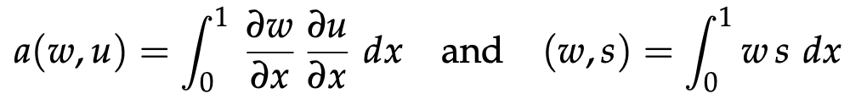
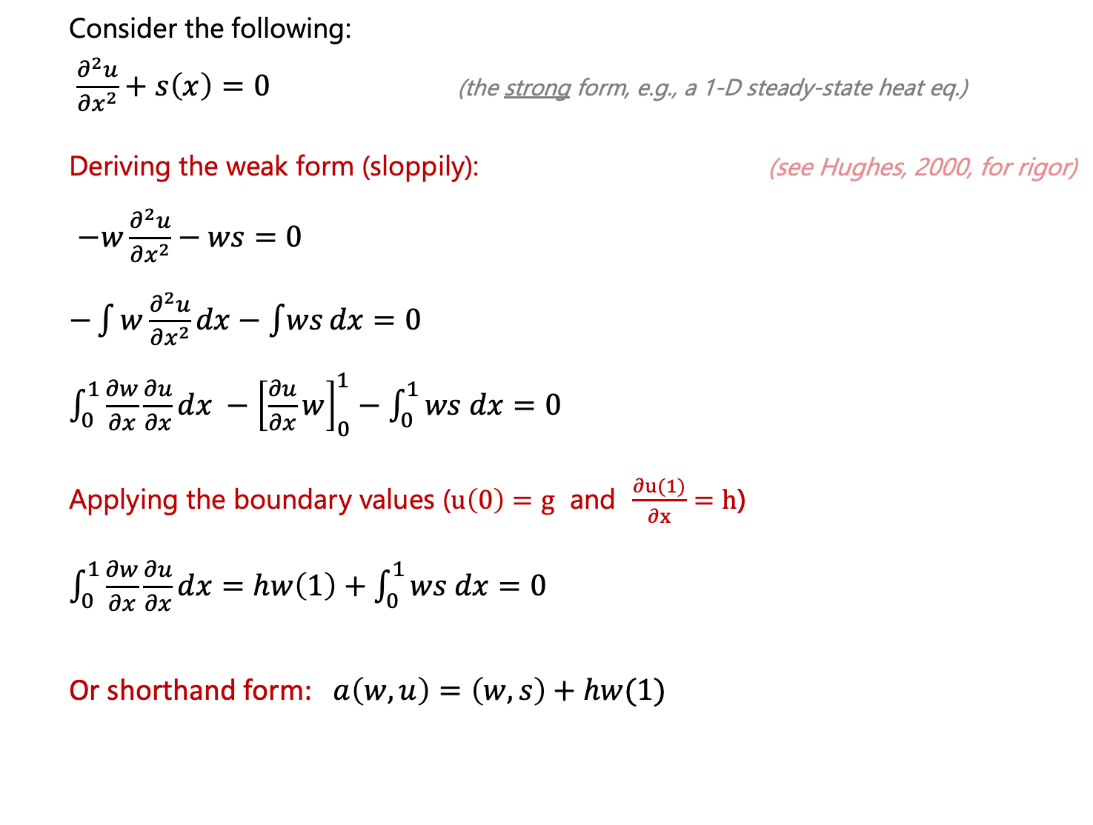
A simple, 1-D example
Consider the following:
$\frac{∂^{2}u}{∂x^{2}}+s\left(x\right)=0$ (the strong form, e.g., a 1-D steady-state heat eq.)
Deriving the weak form (sloppily): (see Hughes, 2000, for rigor)
$−w\frac{∂^{2}u}{∂x^{2}}−ws=0$
$−\int{w\frac{∂^{2}u}{∂x^{2}}}dx−\int{ws}dx=0$
$\int_{0}^{1}{\frac{∂w}{∂x}\frac{∂u}{∂x}dx} −{\left[\frac{∂u}{∂x}w\right]}_{0}^{1}−\int_{0}^{1}{ws dx}=0$
Applying the boundary values ($u\left(0\right)=g$ and $\frac{∂u(1)}{∂x}=h$)
$\int_{0}^{1}{\frac{∂w}{∂x}\frac{∂u}{∂x}dx}=hw\left(1\right)+\int_{0}^{1}{ws dx}=0$
Or shorthand form: $a\left(w,u\right)=\left(w,s\right)+hw(1)$
Notation

Slide 18
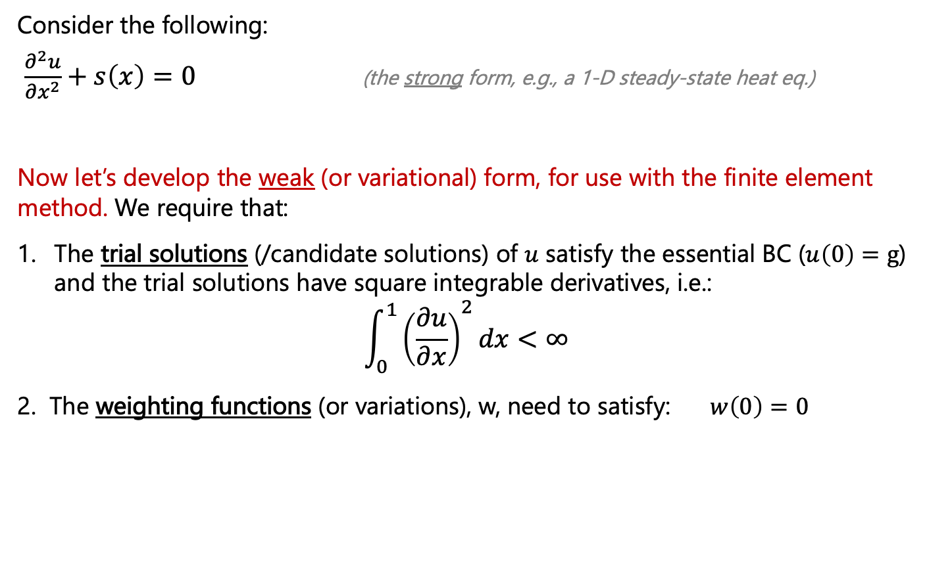
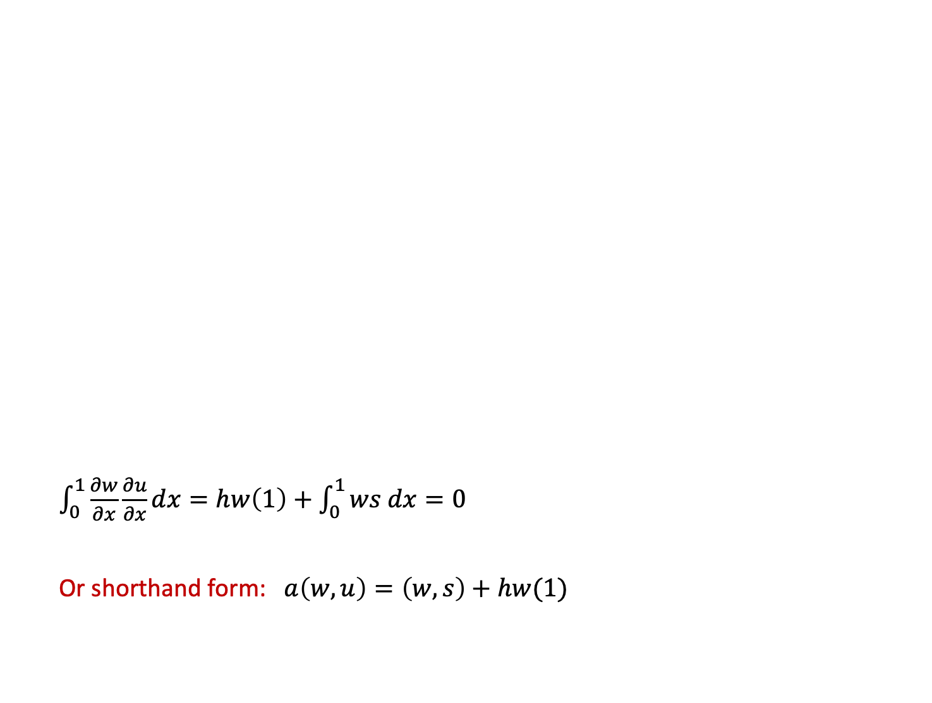
A simple, 1-D example
Consider the following:
$\frac{∂^{2}u}{∂x^{2}}+s\left(x\right)=0$ (the strong form, e.g., a 1-D steady-state heat eq.)
Deriving the weak form (sloppily): (see Hughes, 2000, for rigor)
$−w\frac{∂^{2}u}{∂x^{2}}−ws=0$
$−\int{w\frac{∂^{2}u}{∂x^{2}}}dx−\int{ws}dx=0$
$\int_{0}^{1}{\frac{∂w}{∂x}\frac{∂u}{∂x}dx} −{\left[\frac{∂u}{∂x}w\right]}_{0}^{1}−\int_{0}^{1}{ws dx}=0$
Applying the boundary values ($u\left(0\right)=g$ and $\frac{∂u(1)}{∂x}=h$)
$\int_{0}^{1}{\frac{∂w}{∂x}\frac{∂u}{∂x}dx}=hw\left(1\right)+\int_{0}^{1}{ws dx}=0$
Or shorthand form: $a\left(w,u\right)=\left(w,s\right)+hw(1)$
Consider the following:
$\frac{∂^{2}u}{∂x^{2}}+s\left(x\right)=0$ (the strong form, e.g., a 1-D steady-state heat eq.)
Now let’s develop the weak (or variational) form, for use with the finite element method. We require that:
The trial solutions (/candidate solutions) of $u$ satisfy the essential BC ($u\left(0\right)=g$) and the trial solutions have square integrable derivatives, i.e.:
$$\int_{0}^{1}{{\left(\frac{∂u}{∂x}\right)}^{2}dx<∞}$$
2. The weighting functions (or variations), w, need to satisfy: $w\left(0\right)=0$
Given h, g, s, we are searching for a u (trial solution) that satisfies this weak form for all w (weighting functions)

Slide 19
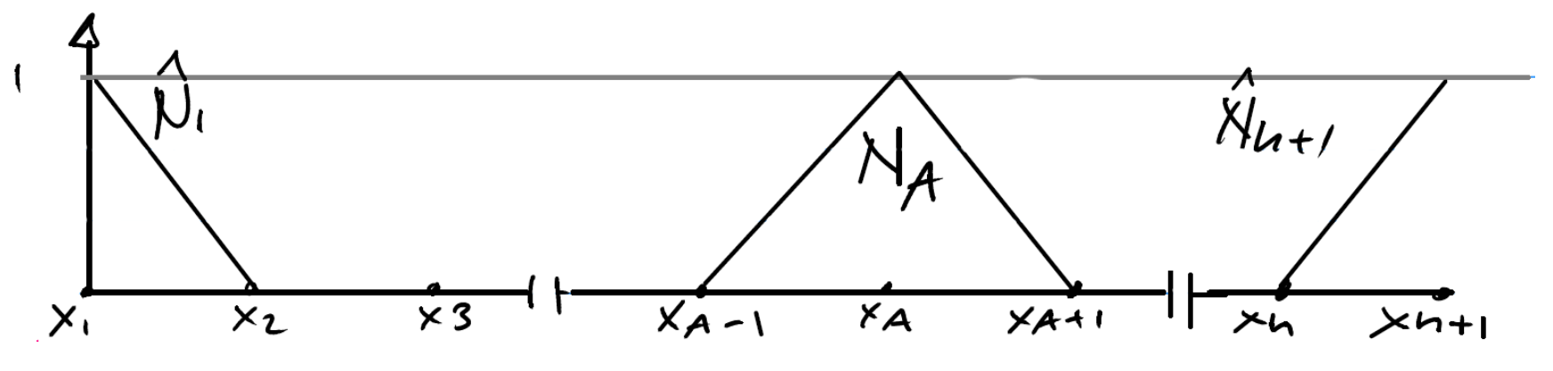
A simple, 1-D example
Consider the following:
$\frac{∂^{2}u}{∂x^{2}}+s\left(x\right)=0$ (the strong form, e.g., a 1-D steady-state heat eq.)
Deriving the weak form (sloppily): (see Hughes, 2000, for rigor)
$−w\frac{∂^{2}u}{∂x^{2}}−ws=0$
$−\int{w\frac{∂^{2}u}{∂x^{2}}}dx−\int{ws}dx=0$
$\int_{0}^{1}{\frac{∂w}{∂x}\frac{∂u}{∂x}dx} −{\left[\frac{∂u}{∂x}w\right]}_{0}^{1}−\int_{0}^{1}{ws dx}=0$
Applying the boundary values ($u\left(0\right)=g$ and $\frac{∂u(1)}{∂x}=h$)
$\int_{0}^{1}{\frac{∂w}{∂x}\frac{∂u}{∂x}dx}=hw\left(1\right)+\int_{0}^{1}{ws dx}=0$
Or shorthand form: $a\left(w,u\right)=\left(w,s\right)+hw(1)$
Examples of these polynomial functions (i.e., w and u ) on a 1-D mesh
Given h, g, s, we are searching for a u (trial solution) that satisfies this weak form for all w (weighting functions)

Slide 20
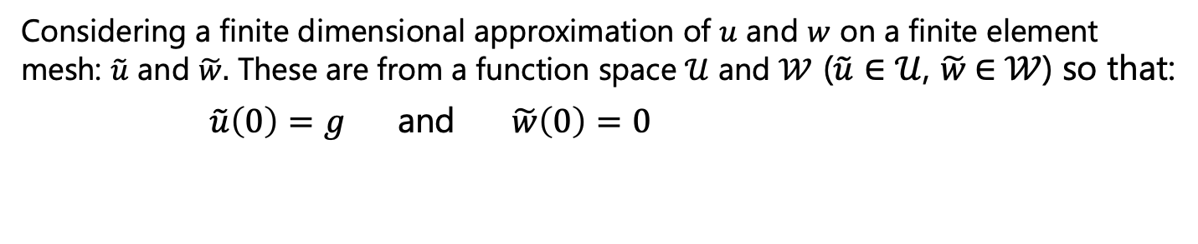
Solving the weak form: The Galerkin method
Considering a finite dimensional approximation of $u$ and $w$ on a finite element mesh: $\tilde{u}$ and $\tilde{w}.$ These are from a function space $𝒰$ and $𝒲$ ($\tilde{u}∈$ $𝒰$, $\tilde{w}$ $∈$ $𝒲$) so that:
$\tilde{u}\left(0\right)=g$ and $\tilde{w}\left(0\right)=0$

Slide 21
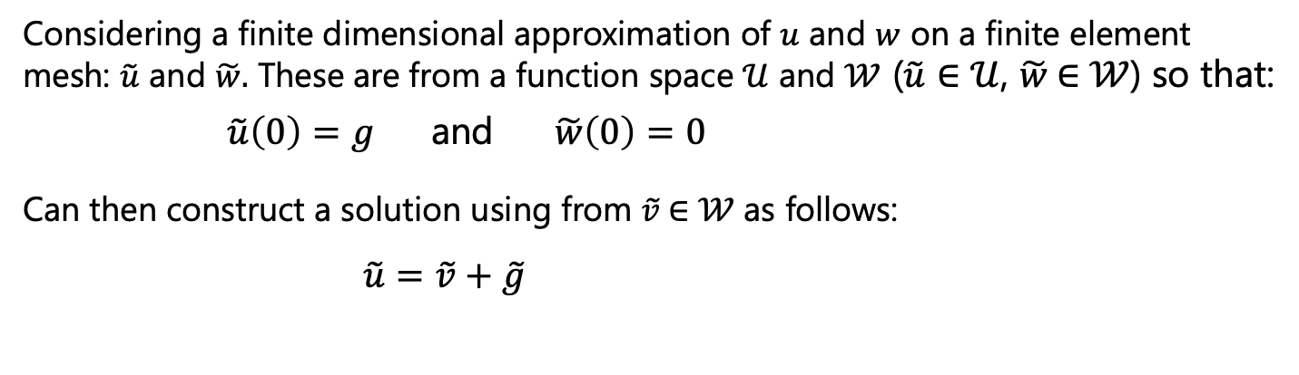
Solving the weak form: The Galerkin method
Considering a finite dimensional approximation of $u$ and $w$ on a finite element mesh: $\tilde{u}$ and $\tilde{w}.$ These are from a function space $𝒰$ and $𝒲$ ($\tilde{u}∈$ $𝒰$, $\tilde{w}$ $∈$ $𝒲$) so that:
$\tilde{u}\left(0\right)=g$ and $\tilde{w}\left(0\right)=0$
Can then construct a solution using from $\tilde{v}$ $∈$ $𝒲$ as follows:
$\tilde{u}=$ $\tilde{v}+\tilde{g}$

Slide 22
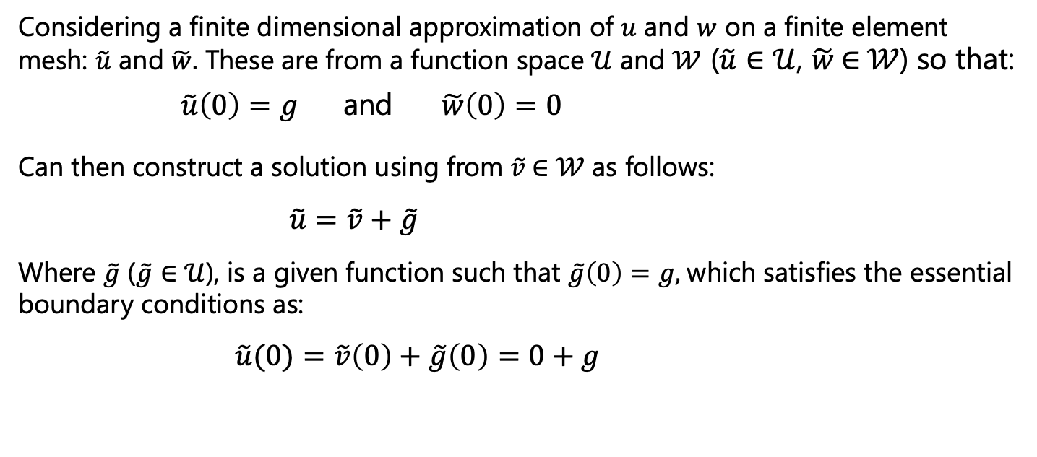
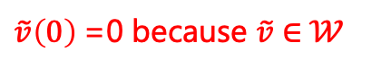
Solving the weak form: The Galerkin method
Considering a finite dimensional approximation of $u$ and $w$ on a finite element mesh: $\tilde{u}$ and $\tilde{w}.$ These are from a function space $𝒰$ and $𝒲$ ($\tilde{u}∈$ $𝒰$, $\tilde{w}$ $∈$ $𝒲$) so that:
$\tilde{u}\left(0\right)=g$ and $\tilde{w}\left(0\right)=0$
Can then construct a solution using from $\tilde{v}$ $∈$ $𝒲$ as follows:
$\tilde{u}=$ $\tilde{v}+\tilde{g}$
Where $\tilde{g}$ ($\tilde{g}∈$ $𝒰$), is a given function such that $\tilde{g}\left(0\right)=g,$which satisfies the essential boundary conditions as:
$\tilde{u}(0)=$ $\tilde{v}\left(0\right)+\tilde{g}\left(0\right)=0+g$
$\tilde{v}\left(0\right)$=0 because $\tilde{v}$ $∈$ $𝒲$

Slide 23
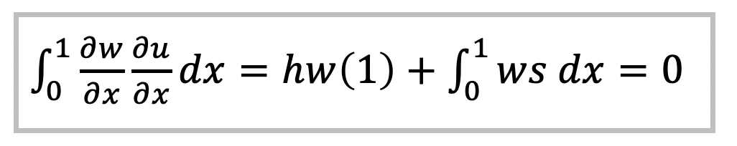
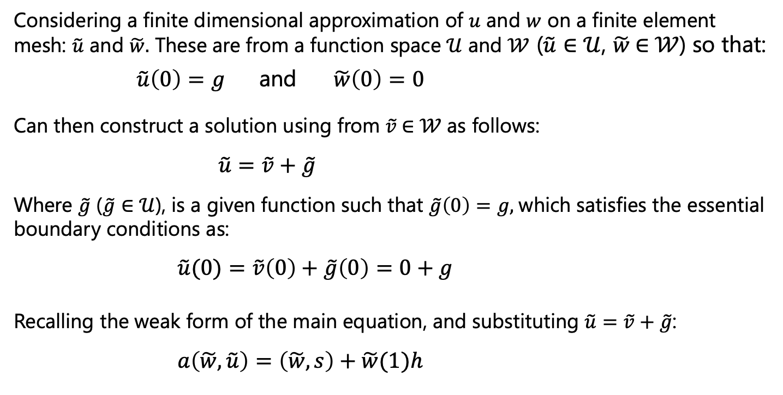
Solving the weak form: The Galerkin method
Considering a finite dimensional approximation of $u$ and $w$ on a finite element mesh: $\tilde{u}$ and $\tilde{w}.$ These are from a function space $𝒰$ and $𝒲$ ($\tilde{u}∈$ $𝒰$, $\tilde{w}$ $∈$ $𝒲$) so that:
$\tilde{u}\left(0\right)=g$ and $\tilde{w}\left(0\right)=0$
Can then construct a solution using from $\tilde{v}$ $∈$ $𝒲$ as follows:
$\tilde{u}=$ $\tilde{v}+\tilde{g}$
Where $\tilde{g}$ ($\tilde{g}∈$ $𝒰$), is a given function such that $\tilde{g}\left(0\right)=g,$which satisfies the essential boundary conditions as:
$\tilde{u}(0)=$ $\tilde{v}\left(0\right)+\tilde{g}\left(0\right)=0+g$
Recalling the weak form of the main equation, and substituting $\tilde{u}=$ $\tilde{v}+\tilde{g}$:
$a\left(\tilde{w},\tilde{u}\right)=\left(\tilde{w},s\right)+\tilde{w}(1)h$
$\tilde{v}\left(0\right)$=0 because $\tilde{v}$ $∈$ $𝒲$

Slide 24
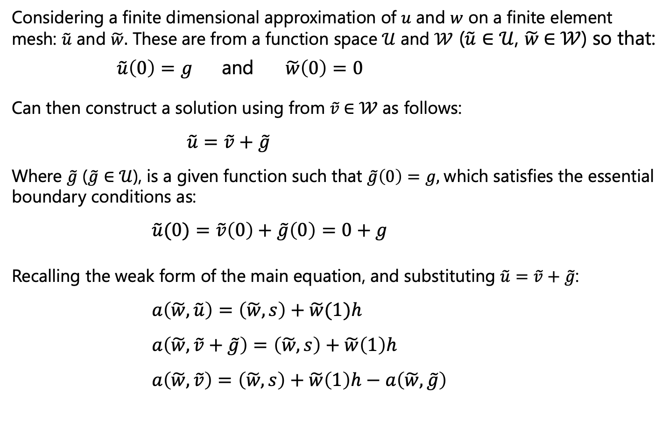
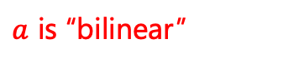
Solving the weak form: The Galerkin method
Considering a finite dimensional approximation of $u$ and $w$ on a finite element mesh: $\tilde{u}$ and $\tilde{w}.$ These are from a function space $𝒰$ and $𝒲$ ($\tilde{u}∈$ $𝒰$, $\tilde{w}$ $∈$ $𝒲$) so that:
$\tilde{u}\left(0\right)=g$ and $\tilde{w}\left(0\right)=0$
Can then construct a solution using from $\tilde{v}$ $∈$ $𝒲$ as follows:
$\tilde{u}=$ $\tilde{v}+\tilde{g}$
Where $\tilde{g}$ ($\tilde{g}∈$ $𝒰$), is a given function such that $\tilde{g}\left(0\right)=g,$which satisfies the essential boundary conditions as:
$\tilde{u}(0)=$ $\tilde{v}\left(0\right)+\tilde{g}\left(0\right)=0+g$
Recalling the weak form of the main equation, and substituting $\tilde{u}=$ $\tilde{v}+\tilde{g}$:
$a\left(\tilde{w},\tilde{u}\right)=\left(\tilde{w},s\right)+\tilde{w}(1)h$
$a\left(\tilde{w},\tilde{v}+\tilde{g}\right)=\left(\tilde{w},s\right)+\tilde{w}\left(1\right)h$
$a\left(\tilde{w},\tilde{v}\right)=\left(\tilde{w},s\right)+\tilde{w}\left(1\right)h−a\left(\tilde{w},\tilde{g}\right)$
$\tilde{v}\left(0\right)$=0 because $\tilde{v}$ $∈$ $𝒲$
$a$ is “bilinear”

Slide 25
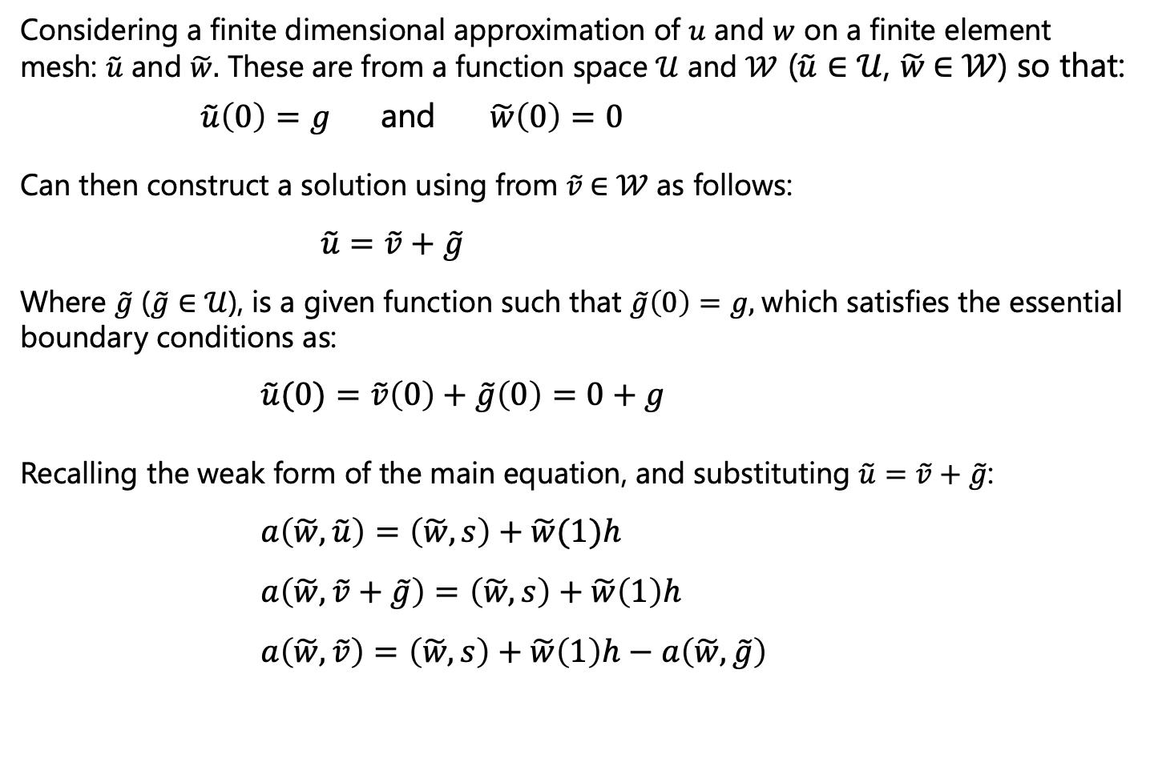
Solving the weak form: The Galerkin method
Considering a finite dimensional approximation of $u$ and $w$ on a finite element mesh: $\tilde{u}$ and $\tilde{w}.$ These are from a function space $𝒰$ and $𝒲$ ($\tilde{u}∈$ $𝒰$, $\tilde{w}$ $∈$ $𝒲$) so that:
$\tilde{u}\left(0\right)=g$ and $\tilde{w}\left(0\right)=0$
Can then construct a solution using from $\tilde{v}$ $∈$ $𝒲$ as follows:
$\tilde{u}=$ $\tilde{v}+\tilde{g}$
Where $\tilde{g}$ ($\tilde{g}∈$ $𝒰$), is a given function such that $\tilde{g}\left(0\right)=g,$which satisfies the essential boundary conditions as:
$\tilde{u}(0)=$ $\tilde{v}\left(0\right)+\tilde{g}\left(0\right)=0+g$
Recalling the weak form of the main equation, and substituting $\tilde{u}=$ $\tilde{v}+\tilde{g}$:
$a\left(\tilde{w},\tilde{u}\right)=\left(\tilde{w},s\right)+\tilde{w}(1)h$
$a\left(\tilde{w},\tilde{v}+\tilde{g}\right)=\left(\tilde{w},s\right)+\tilde{w}\left(1\right)h$
$a\left(\tilde{w},\tilde{v}\right)=\left(\tilde{w},s\right)+\tilde{w}\left(1\right)h−a\left(\tilde{w},\tilde{g}\right)$
LHS: Solution
RHS: knowns/BCs

Slide 26
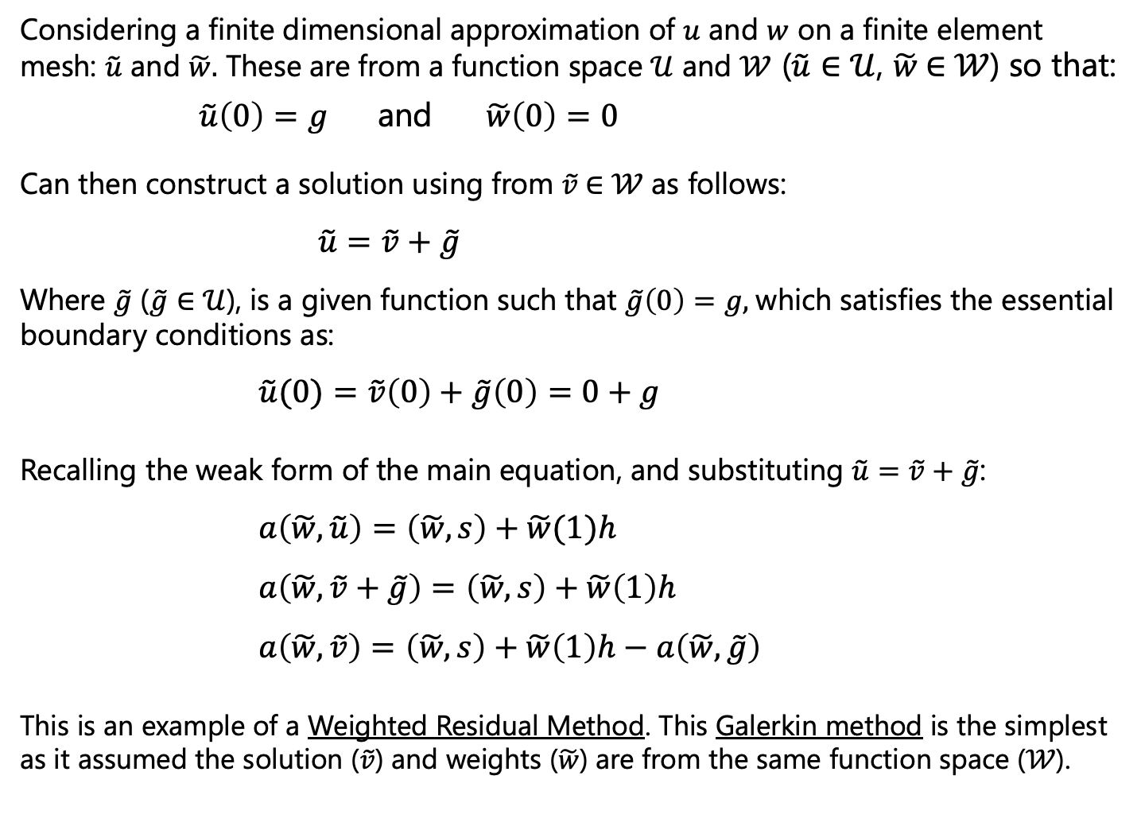
Solving the weak form: The Galerkin method
Considering a finite dimensional approximation of $u$ and $w$ on a finite element mesh: $\tilde{u}$ and $\tilde{w}.$ These are from a function space $𝒰$ and $𝒲$ ($\tilde{u}∈$ $𝒰$, $\tilde{w}$ $∈$ $𝒲$) so that:
$\tilde{u}\left(0\right)=g$ and $\tilde{w}\left(0\right)=0$
Can then construct a solution using from $\tilde{v}$ $∈$ $𝒲$ as follows:
$\tilde{u}=$ $\tilde{v}+\tilde{g}$
Where $\tilde{g}$ ($\tilde{g}∈$ $𝒰$), is a given function such that $\tilde{g}\left(0\right)=g,$which satisfies the essential boundary conditions as:
$\tilde{u}(0)=$ $\tilde{v}\left(0\right)+\tilde{g}\left(0\right)=0+g$
Recalling the weak form of the main equation, and substituting $\tilde{u}=$ $\tilde{v}+\tilde{g}$:
$a\left(\tilde{w},\tilde{u}\right)=\left(\tilde{w},s\right)+\tilde{w}(1)h$
$a\left(\tilde{w},\tilde{v}+\tilde{g}\right)=\left(\tilde{w},s\right)+\tilde{w}\left(1\right)h$
$a\left(\tilde{w},\tilde{v}\right)=\left(\tilde{w},s\right)+\tilde{w}\left(1\right)h−a\left(\tilde{w},\tilde{g}\right)$
This is an example of a Weighted Residual Method. This Galerkin method is the simplest as it assumed the solution ($\tilde{v}$) and weights ($\tilde{w}$) are from the same function space ($𝒲$).

Slide 27
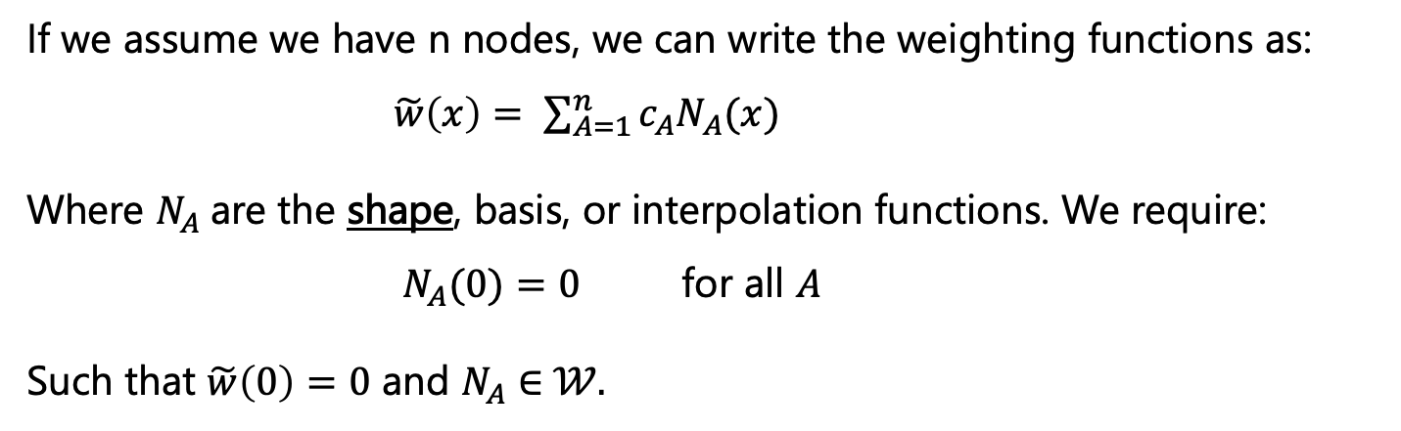
In practice: Shape functions and discretization
If we assume we have n nodes, we can write the weighting functions as:
$\tilde{w}\left(x\right)= \sum_{A=1}^{n}{{c_{A}N}_{A}(x)}$
Where $N_{A}$are the shape, basis, or interpolation functions. We require:
$N_{A}(0)=0$ for all $A$
Such that $\tilde{w}\left(0\right)=0$ and $N_{A}∈$ $𝒲.$

Slide 28
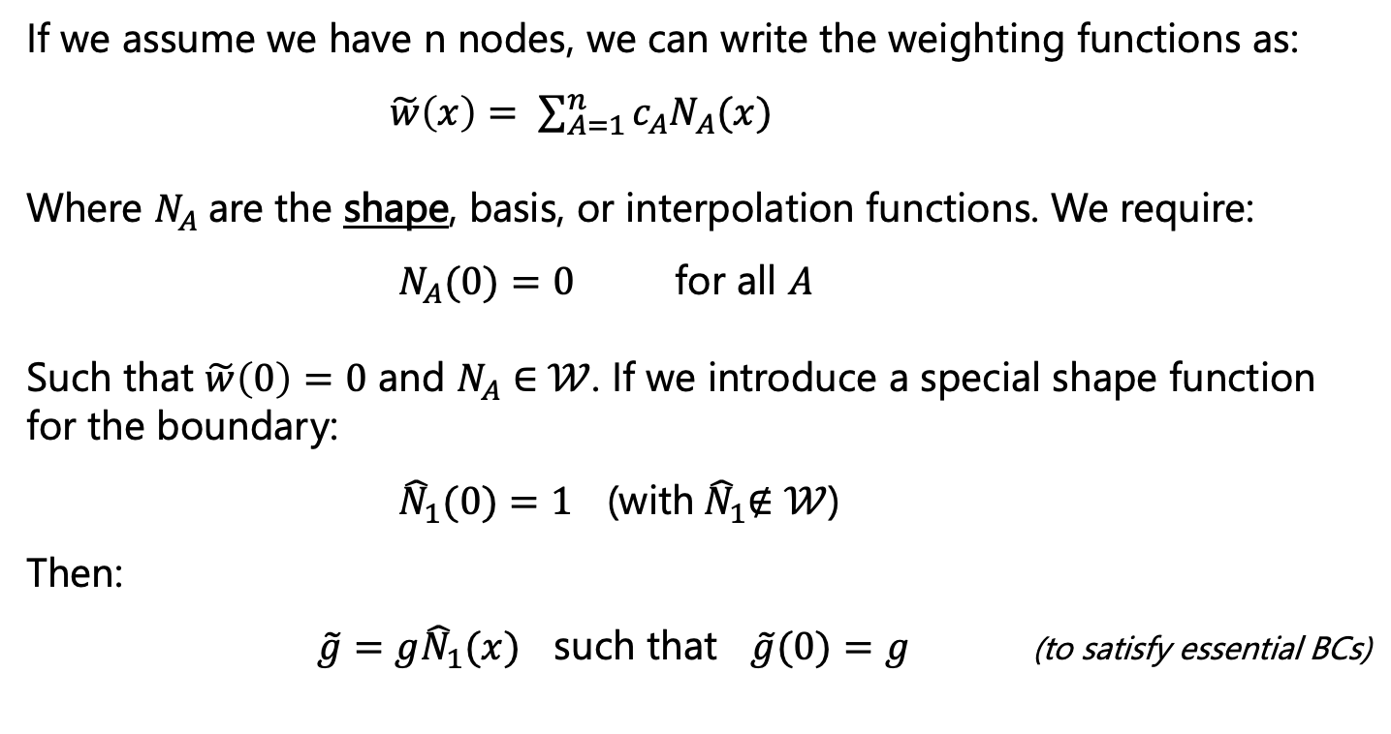
In practice: Shape functions and discretization
If we assume we have n nodes, we can write the weighting functions as:
$\tilde{w}\left(x\right)= \sum_{A=1}^{n}{{c_{A}N}_{A}(x)}$
Where $N_{A}$are the shape, basis, or interpolation functions. We require:
$N_{A}(0)=0$ for all $A$
Such that $\tilde{w}\left(0\right)=0$ and $N_{A}∈$ $𝒲$. If we introduce a special shape function for the boundary:
${\hat{N}}_{1}(0)=1$ (with${ \hat{N}}_{1}∉𝒲$)
Then:
$\tilde{g}={g\hat{N}}_{1}(x)$ such that $\tilde{g}(0)=g$ (to satisfy essential BCs)

Slide 29
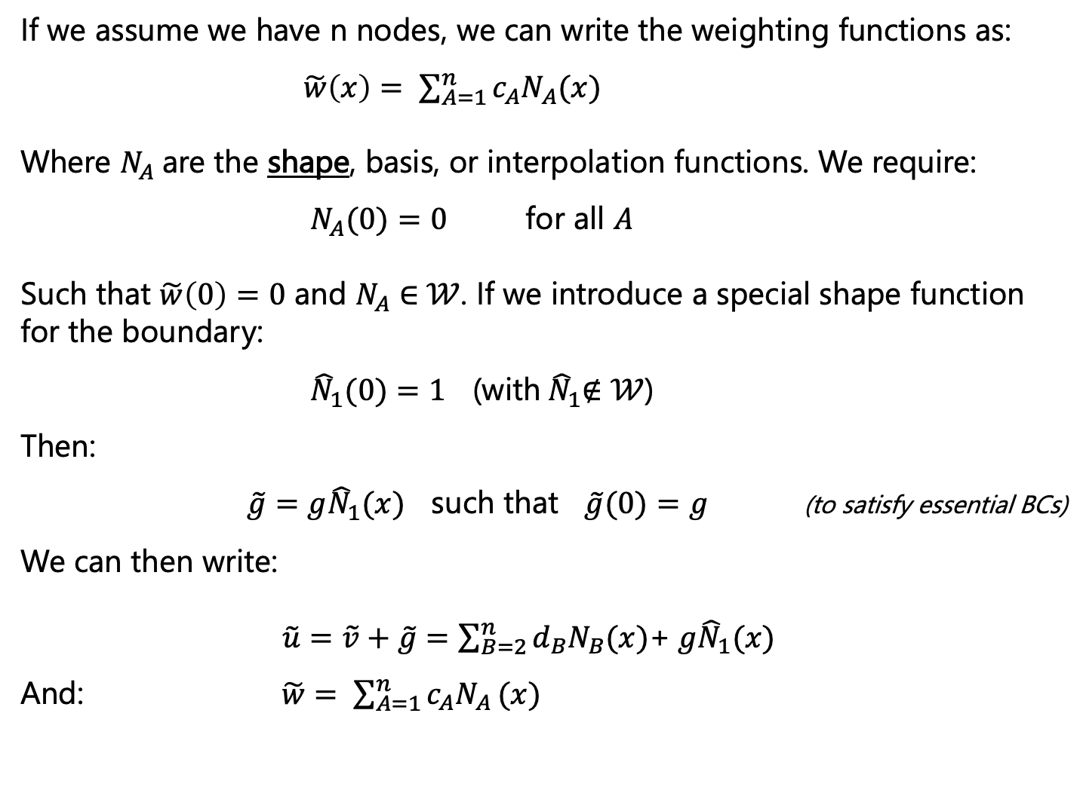
In practice: Shape functions and discretization
If we assume we have n nodes, we can write the weighting functions as:
$\tilde{w}\left(x\right)= \sum_{A=1}^{n}{{c_{A}N}_{A}(x)}$
Where $N_{A}$are the shape, basis, or interpolation functions. We require:
$N_{A}(0)=0$ for all $A$
Such that $\tilde{w}\left(0\right)=0$ and $N_{A}∈$ $𝒲$. If we introduce a special shape function for the boundary:
${\hat{N}}_{1}(0)=1$ (with${ \hat{N}}_{1}∉𝒲$)
Then:
$\tilde{g}={g\hat{N}}_{1}(x)$ such that $\tilde{g}(0)=g$ (to satisfy essential BCs)
We can then write:
$\tilde{u}=$ $\tilde{v}+\tilde{g}=$ $\sum_{B=2}^{n}{{d_{B}N}_{B}(x)}$+ ${g\hat{N}}_{1}(x)$
And: $\tilde{w}= \sum_{A=1}^{n}{{c_{A}N}_{A}}(x)$

Slide 30
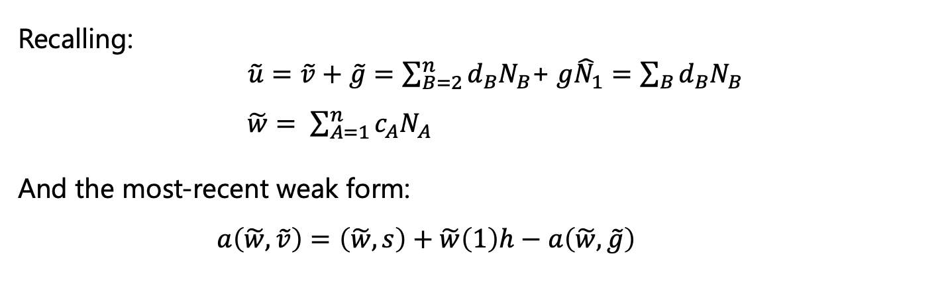
In practice: Shape functions and discretization
Recalling:
$\tilde{u}=$ $\tilde{v}+\tilde{g}=$ $\sum_{B=2}^{n}{{d_{B}N}_{B}}$+ ${g\hat{N}}_{1}=\sum_{B}{{d_{B}N}_{B}}$
$\tilde{w}= \sum_{A=1}^{n}{{c_{A}N}_{A}}$
And the most-recent weak form:
$a\left(\tilde{w},\tilde{v}\right)=\left(\tilde{w},s\right)+\tilde{w}\left(1\right)h−a\left(\tilde{w},\tilde{g}\right)$

Slide 31
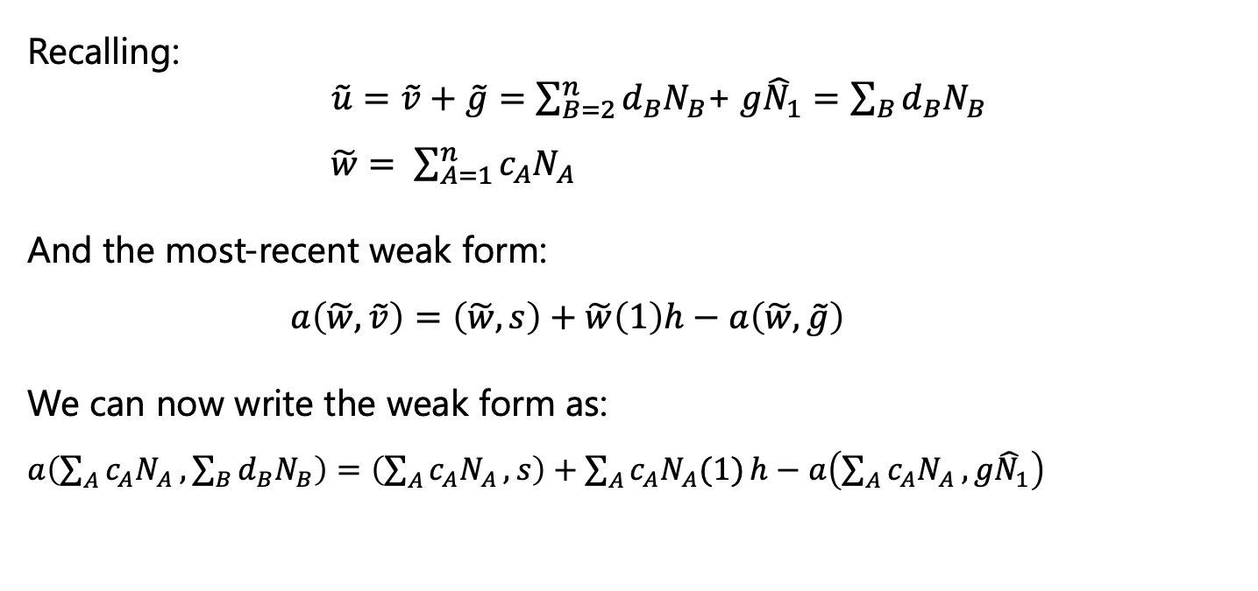
In practice: Shape functions and discretization
Recalling:
$\tilde{u}=$ $\tilde{v}+\tilde{g}=$ $\sum_{B=2}^{n}{{d_{B}N}_{B}}$+ ${g\hat{N}}_{1}=\sum_{B}{{d_{B}N}_{B}}$
$\tilde{w}= \sum_{A=1}^{n}{{c_{A}N}_{A}}$
And the most-recent weak form:
$a\left(\tilde{w},\tilde{v}\right)=\left(\tilde{w},s\right)+\tilde{w}\left(1\right)h−a\left(\tilde{w},\tilde{g}\right)$
We can now write the weak form as:
$a\left(\sum_{A}{{c_{A}N}_{A}},\sum_{B}{{d_{B}N}_{B}}\right)=\left(\sum_{A}{{c_{A}N}_{A}},s\right)+\sum_{A}{{c_{A}N}_{A}(1)}h−a\left(\sum_{A}{{c_{A}N}_{A}},{g\hat{N}}_{1}\right)$

Slide 32
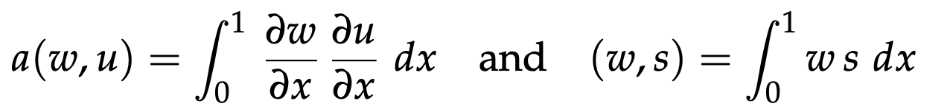
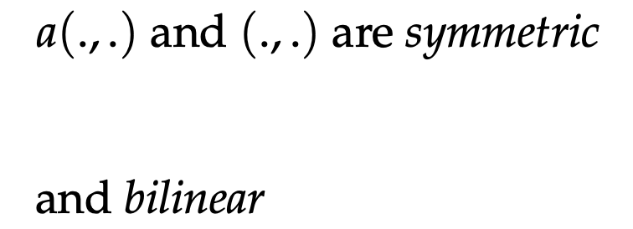
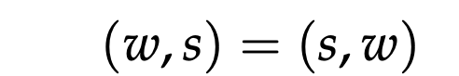
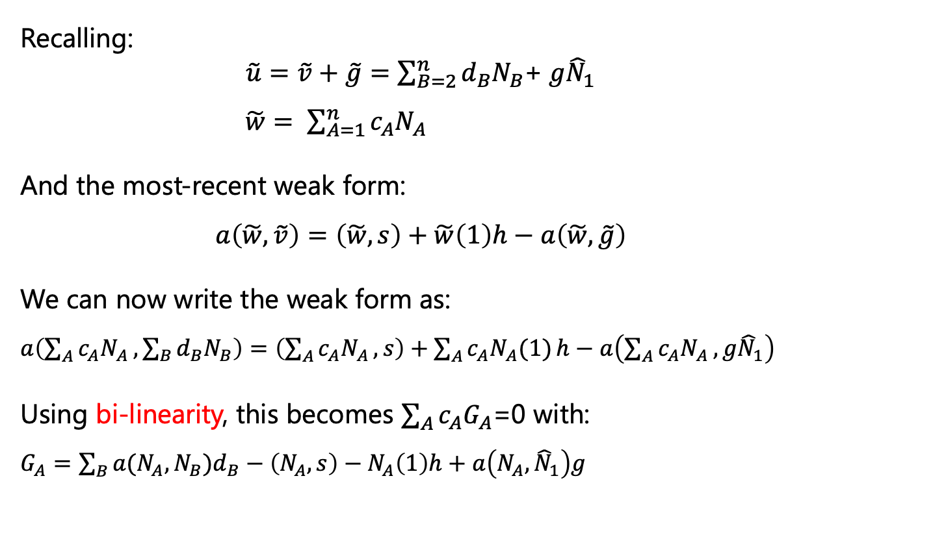
In practice: Shape functions and discretization
Recalling:
$\tilde{u}=$ $\tilde{v}+\tilde{g}=$ $\sum_{B=2}^{n}{{d_{B}N}_{B}}$+ ${g\hat{N}}_{1}$
$\tilde{w}= \sum_{A=1}^{n}{{c_{A}N}_{A}}$
And the most-recent weak form:
$a\left(\tilde{w},\tilde{v}\right)=\left(\tilde{w},s\right)+\tilde{w}\left(1\right)h−a\left(\tilde{w},\tilde{g}\right)$
We can now write the weak form as:
$a\left(\sum_{A}{{c_{A}N}_{A}},\sum_{B}{{d_{B}N}_{B}}\right)=\left(\sum_{A}{{c_{A}N}_{A}},s\right)+\sum_{A}{{c_{A}N}_{A}(1)}h−a\left(\sum_{A}{{c_{A}N}_{A}},{g\hat{N}}_{1}\right)$
Using bi-linearity, this becomes $\sum_{A}{{c_{A}G}_{A}}$=0 with:
$G_{A}=\sum_{B}{{a({N_{A},N}_{B})d}_{B}}−\left(N_{A},s\right)−N_{A}\left(1\right)h+a\left(N_{A},{\hat{N}}_{1}\right)g$

Slide 33
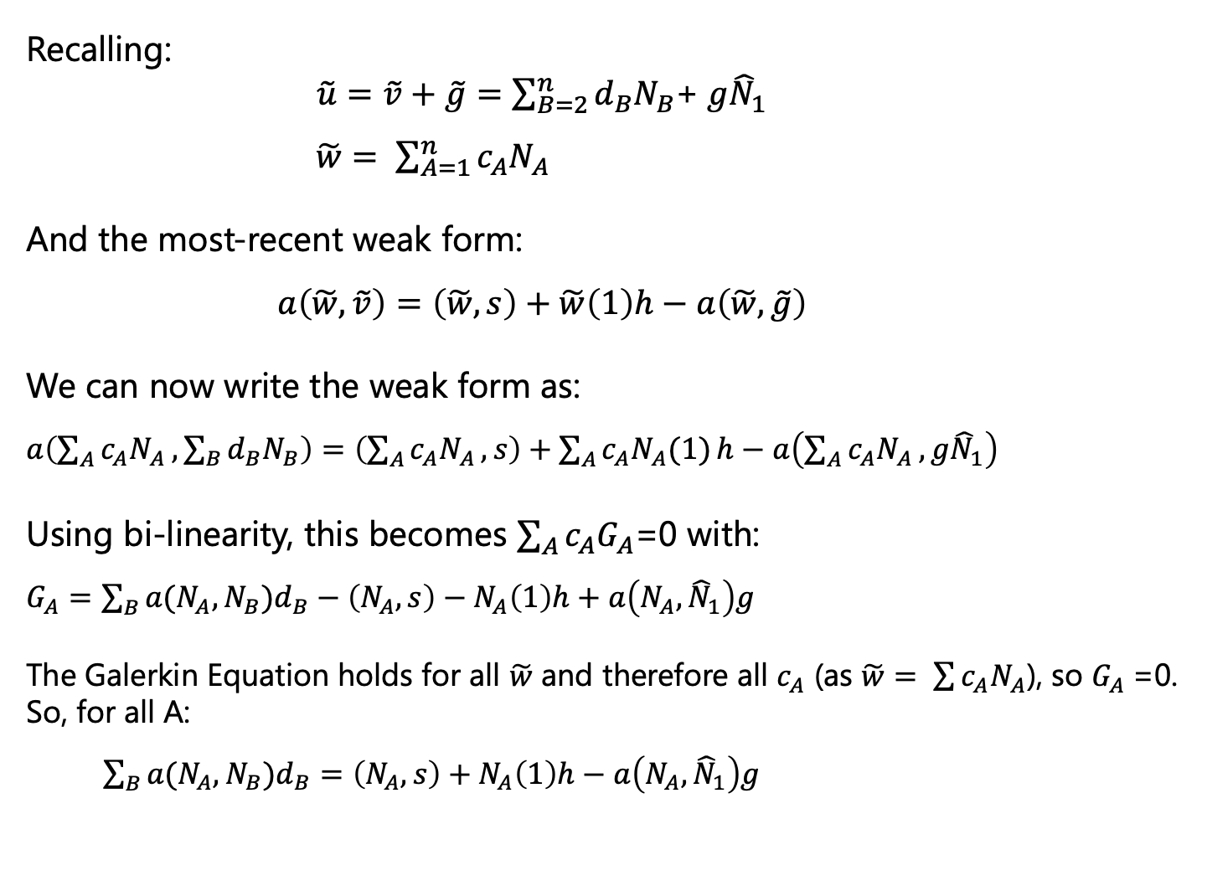
In practice: Shape functions and discretization
Recalling:
$\tilde{u}=$ $\tilde{v}+\tilde{g}=$ $\sum_{B=2}^{n}{{d_{B}N}_{B}}$+ ${g\hat{N}}_{1}$
$\tilde{w}= \sum_{A=1}^{n}{{c_{A}N}_{A}}$
And the most-recent weak form:
$a\left(\tilde{w},\tilde{v}\right)=\left(\tilde{w},s\right)+\tilde{w}\left(1\right)h−a\left(\tilde{w},\tilde{g}\right)$
We can now write the weak form as:
$a\left(\sum_{A}{{c_{A}N}_{A}},\sum_{B}{{d_{B}N}_{B}}\right)=\left(\sum_{A}{{c_{A}N}_{A}},s\right)+\sum_{A}{{c_{A}N}_{A}(1)}h−a\left(\sum_{A}{{c_{A}N}_{A}},{g\hat{N}}_{1}\right)$
Using bi-linearity, this becomes $\sum_{A}{{c_{A}G}_{A}}$=0 with:
$G_{A}=\sum_{B}{{a({N_{A},N}_{B})d}_{B}}−\left(N_{A},s\right)−N_{A}\left(1\right)h+a\left(N_{A},{\hat{N}}_{1}\right)g$
The Galerkin Equation holds for all $\tilde{w}$ and therefore all $c_{A}$ (as $\tilde{w}= \sum{{c_{A}N}_{A}}$), so $G_{A}$=0. So, for all A:
$\sum_{B}{{a({N_{A},N}_{B})d}_{B}}=\left(N_{A},s\right)+N_{A}\left(1\right)h−a\left(N_{A},{\hat{N}}_{1}\right)g$

Slide 34
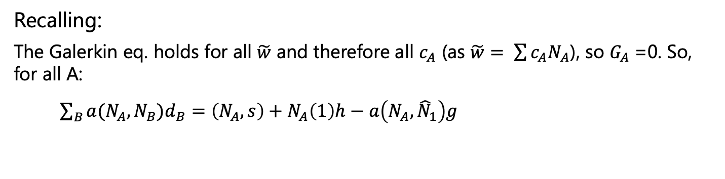
In practice: Shape functions and discretization
Recalling:
The Galerkin eq. holds for all $\tilde{w}$ and therefore all $c_{A}$ (as $\tilde{w}= \sum{{c_{A}N}_{A}}$), so $G_{A}$=0. So, for all A:
$\sum_{B}{{a({N_{A},N}_{B})d}_{B}}=\left(N_{A},s\right)+N_{A}\left(1\right)h−a\left(N_{A},{\hat{N}}_{1}\right)g$

Slide 35
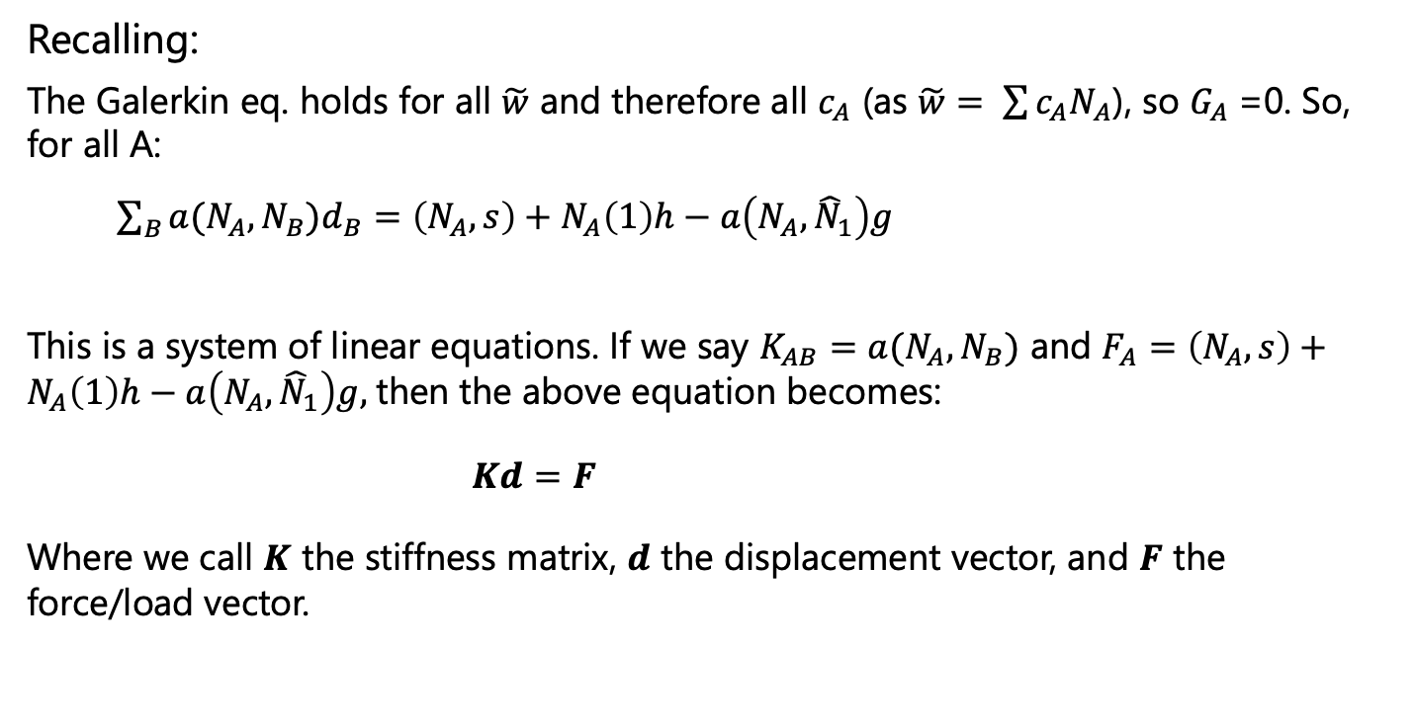
In practice: Shape functions and discretization
Recalling:
The Galerkin eq. holds for all $\tilde{w}$ and therefore all $c_{A}$ (as $\tilde{w}= \sum{{c_{A}N}_{A}}$), so $G_{A}$=0. So, for all A:
$\sum_{B}{{a({N_{A},N}_{B})d}_{B}}=\left(N_{A},s\right)+N_{A}\left(1\right)h−a\left(N_{A},{\hat{N}}_{1}\right)g$
This is a system of linear equations. If we say $K_{AB}=a({N_{A},N}_{B})$ and $F_{A}=\left(N_{A},s\right)+N_{A}\left(1\right)h−a\left(N_{A},{\hat{N}}_{1}\right)g,$then the above equation becomes:
$Kd=F$
Where we call $K$ the stiffness matrix, $d$ the displacement vector, and $F$ the force/load vector.

Slide 36
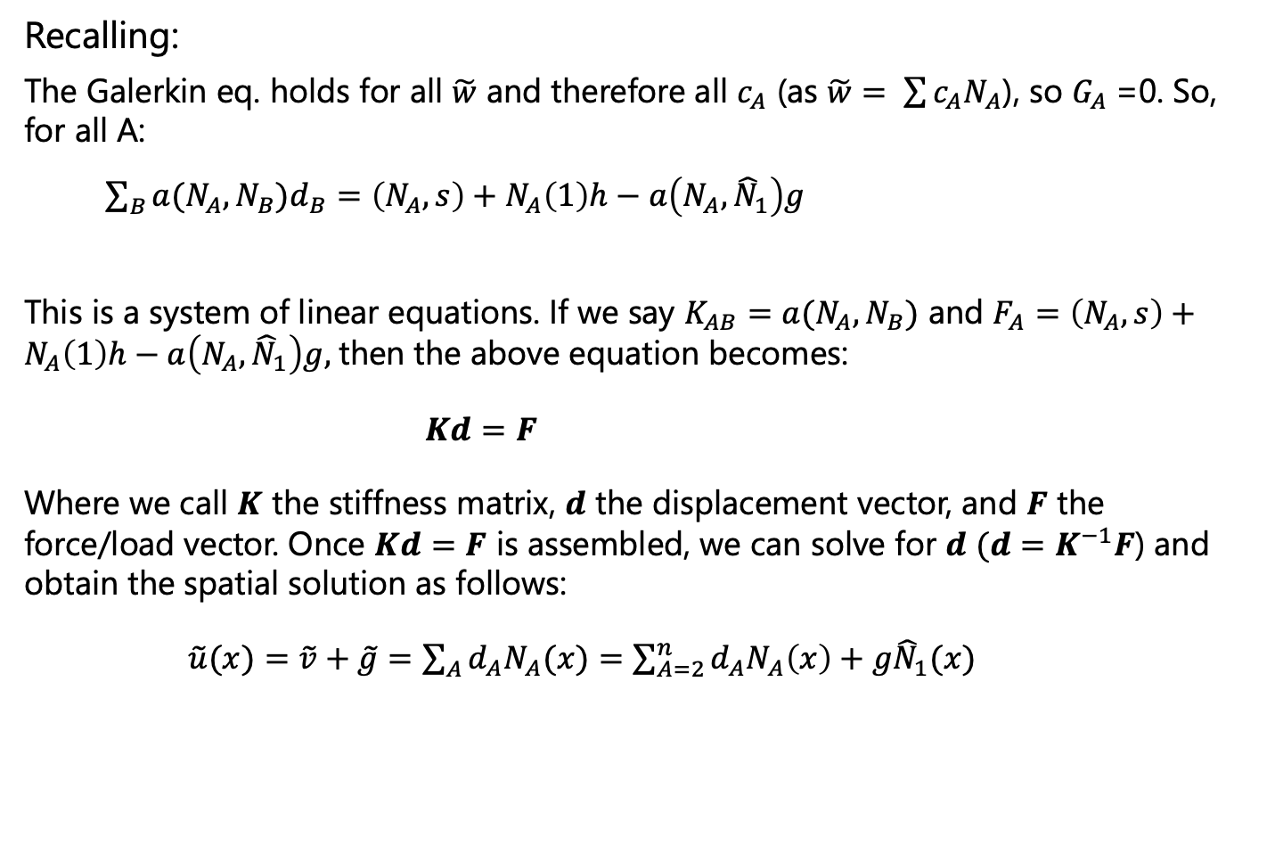
In practice: Shape functions and discretization
Recalling:
The Galerkin eq. holds for all $\tilde{w}$ and therefore all $c_{A}$ (as $\tilde{w}= \sum{{c_{A}N}_{A}}$), so $G_{A}$=0. So, for all A:
$\sum_{B}{{a({N_{A},N}_{B})d}_{B}}=\left(N_{A},s\right)+N_{A}\left(1\right)h−a\left(N_{A},{\hat{N}}_{1}\right)g$
This is a system of linear equations. If we say $K_{AB}=a({N_{A},N}_{B})$ and $F_{A}=\left(N_{A},s\right)+N_{A}\left(1\right)h−a\left(N_{A},{\hat{N}}_{1}\right)g,$then the above equation becomes:
$Kd=F$
Where we call $K$ the stiffness matrix, $d$ the displacement vector, and $F$ the force/load vector. Once $Kd=F$ is assembled, we can solve for $d$ $(d=K^{−1}F$) and obtain the spatial solution as follows:
$\tilde{u}(x)=$ $\tilde{v}+\tilde{g}=\sum_{A}{{d_{A}N}_{A}(x)}=\sum_{A=2}^{n}{{d_{A}N}_{A}\left(x\right)+{g\hat{N}}_{1}(x)}$

Slide 37
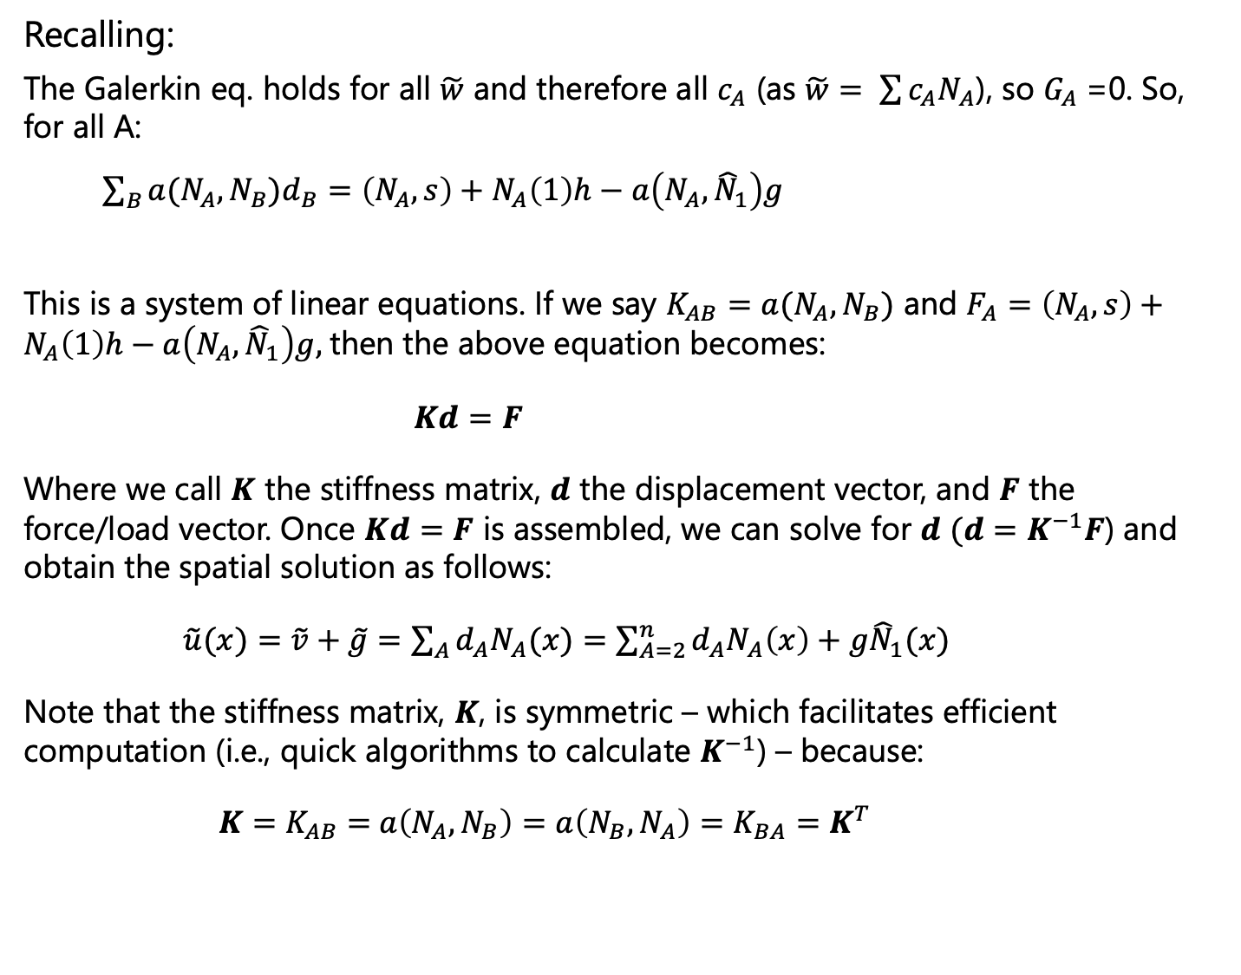
In practice: Shape functions and discretization
Recalling:
The Galerkin eq. holds for all $\tilde{w}$ and therefore all $c_{A}$ (as $\tilde{w}= \sum{{c_{A}N}_{A}}$), so $G_{A}$=0. So, for all A:
$\sum_{B}{{a({N_{A},N}_{B})d}_{B}}=\left(N_{A},s\right)+N_{A}\left(1\right)h−a\left(N_{A},{\hat{N}}_{1}\right)g$
This is a system of linear equations. If we say $K_{AB}=a({N_{A},N}_{B})$ and $F_{A}=\left(N_{A},s\right)+N_{A}\left(1\right)h−a\left(N_{A},{\hat{N}}_{1}\right)g,$then the above equation becomes:
$Kd=F$
Where we call $K$ the stiffness matrix, $d$ the displacement vector, and $F$ the force/load vector. Once $Kd=F$ is assembled, we can solve for $d$ $(d=K^{−1}F$) and obtain the spatial solution as follows:
$\tilde{u}(x)=$ $\tilde{v}+\tilde{g}=\sum_{A}{{d_{A}N}_{A}(x)}=\sum_{A=2}^{n}{{d_{A}N}_{A}\left(x\right)+{g\hat{N}}_{1}(x)}$
Note that the stiffness matrix, $K$, is symmetric – which facilitates efficient computation (i.e., quick algorithms to calculate $K^{−1}$) – because:
$K=K_{AB}=$ $a\left({N_{A},N}_{B}\right)=a\left({N_{B},N}_{A}\right)=K_{BA}=K^{T}$

Slide 38
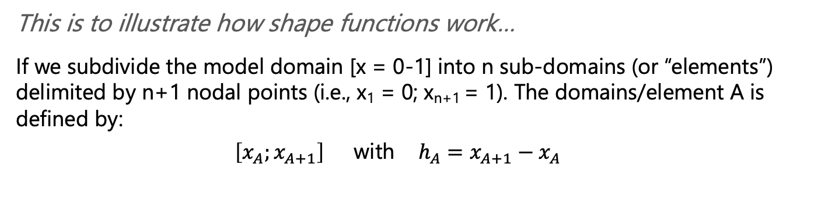
What do shape functions (N_{A}) look like? A 1-D example
This is to illustrate how shape functions work…
If we subdivide the model domain [x = 0-1] into n sub-domains (or “elements”) delimited by n+1 nodal points (i.e., x₁ = 0; x_{n+1} = 1). The domains/element A is defined by:
$\left[x_{A};x_{A+1}\right]$ with $h_{A}=x_{A+1}−x_{A}$

Slide 39



A 1-D example implementation
This is to illustrate how shape functions work…
If we subdivide the model domain [x = 0-1] into n sub-domains (or “elements”) delimited by n+1 nodal points (i.e., x₁ = 0; x_{n+1} = 1). The domains/element A is defined by:
$\left[x_{A};x_{A+1}\right]$ with $h_{A}=x_{A+1}−x_{A}$
Recalling that $\tilde{u}=\sum_{A=1}^{n+1}{{d_{A}N}_{A}\left(x\right)}$, we can choose interior shape functions (2 $≤$ A $≤$ n) as:
And for the boundaries, we use special shape functions:

Slide 40

Becker and Kaus, Numerical Geodynamics
This is to illustrate how shape functions work…
If we subdivide the model domain [x = 0-1] into n sub-domains (or “elements”) delimited by n+1 nodal points (i.e., x₁ = 0; x_{n+1} = 1). The domains/element A is defined by:
$\left[x_{A};x_{A+1}\right]$ with $h_{A}=x_{A+1}−x_{A}$
Recalling that $\tilde{u}=\sum_{A=1}^{n+1}{{d_{A}N}_{A}\left(x\right)}$, we can choose interior shape functions (2 $≤$ A $≤$ n) as:
And for the boundaries, we use special shape functions:
This produces N_{A} = 1 at x = x_{A}, and zero for other nodes.

Slide 41
This is to illustrate how shape functions work…
If we subdivide the model domain [x = 0-1] into n sub-domains (or “elements”) delimited by n+1 nodal points (i.e., x₁ = 0; x_{n+1} = 1). The domains/element A is defined by:
$\left[x_{A};x_{A+1}\right]$ with $h_{A}=x_{A+1}−x_{A}$
Recalling that $\tilde{u}=\sum_{A=1}^{n+1}{{d_{A}N}_{A}\left(x\right)}$, we can choose interior shape functions (2 $≤$ A $≤$ n) as:
And for the boundaries, we use special shape functions:
This produces N_{A} = 1 at x = x_{A}, and zero for other nodes.

Slide 42

This is to illustrate how shape functions work…
If we subdivide the model domain [x = 0-1] into n sub-domains (or “elements”) delimited by n+1 nodal points (i.e., x₁ = 0; x_{n+1} = 1). The domains/element A is defined by:
$\left[x_{A};x_{A+1}\right]$ with $h_{A}=x_{A+1}−x_{A}$
Recalling that $\tilde{u}=\sum_{A=1}^{n+1}{{d_{A}N}_{A}\left(x\right)}$, we can choose interior shape functions (2 $≤$ A $≤$ n) as:
And for the boundaries, we use special shape functions:
This produces N_{A} = 1 at x = x_{A}, and zero for other nodes.

Slide 43

This is to illustrate how shape functions work…
If we subdivide the model domain [x = 0-1] into n sub-domains (or “elements”) delimited by n+1 nodal points (i.e., x₁ = 0; x_{n+1} = 1). The domains/element A is defined by:
$\left[x_{A};x_{A+1}\right]$ with $h_{A}=x_{A+1}−x_{A}$
Recalling that $\tilde{u}=\sum_{A=1}^{n+1}{{d_{A}N}_{A}\left(x\right)}$, we can choose interior shape functions (2 $≤$ A $≤$ n) as:
And for the boundaries, we use special shape functions:
This produces N_{A} = 1 at x = x_{A}, and zero for other nodes.
$K$ [$=K_{AB}=$ $a\left({N_{A},N}_{B}\right)]$ is a sparse matrix because the integral $\int_{0}^{1}{\frac{∂N_{A}}{∂x}\frac{∂N_{B}}{∂x}dx}$ is zero for B > A+1 and B < A-1.
And, as mentioned before, a symmetric matrix.
Lastly a banded matrix (non-zero entries confined to a diagonal band).
All such properties enable very efficient solutions of $Kd=F$

Slide 44


Shape functions in 2-D
1st order (linear) elements. Analogous to the 1-D example.
2nd order (quadratic) elements.

Slide 45

Shape functions in 2-D
1st order (linear) elements. Analogous to the 1-D example.
2nd order (quadratic) elements.
More nodes (”integration points”) required to capture higher order shape functions (and solution variability)
P-2 element (6 nodes, for quadratic element)
P-1 element (3 nodes, for linear element)

Slide 46
Shape functions in 2-D
1st order (linear) elements. Analogous to the 1-D example.
2nd order (quadratic) elements.
Choice depends on the equation to be solved (and, in some cases, the domain geometry)
More nodes (”integration points”) required to capture higher order shape functions (and solution variability)
P-2 element (6 nodes, for quadratic element)
P-1 element (3 nodes, for linear element)

Slide 47
Shape functions in 2-D
Important exercise:
Understand the finite element algorithm of your modeling code (ASPECT? COMSOL?)
Figure out what type of elements your code uses and why.
More nodes (”integration points”) required to capture higher order shape functions (and solution variability)
P-2 element (6 nodes, for quadratic element)
P-1 element (3 nodes, for linear element)

Slide 48

Lots and lots of other important FE topics, e.g.:
Computing finite element operations – i.e. (.., ..) and a(.., ..) – in local (i.e., within the element) vs. global (i.e., within the whole model) coordinates, and how to switch between the two.
Efficiently assembling $K$ (can be a very big matrix!). Often assemble mini $K_{local}$ (per element) and then combine into $K_{global}$
Efficiently solving $Kd=F$ (very large systems of linear equations). Two main endmembers:
Direct solvers (manipulating $K$ and then computing the inverse; sometimes not computationally feasible).
Iterative solvers (a large suite of methods for iteratively computing the $d$).

Slide 49


Further reading

Slide 50

Further reading

Slide 51

For a more practical example
Becker and Kaus, Numerical Geodynamics

Slide 52
Take homes:
Finite element method a key strategy for modeling fluid and solid mechanics problems.
The first two steps of developing a finite element approach are deriving the weak form of the governing equation and splitting the model domain up into sub-domains (finite elements).
Once an element type (order, number of “integraton points”) is chosen, polynomial (or “shape”) functions are used to weight the solution within the node.
Using these shape functions, the weak form can be manipulated into a large system of linear equations, which then can be solved for the shape function coefficients and, in turn, the overall solution.

